Slide 1
Analysis of Algorithms
CS 1037a – Topic 13

Slide 2
Overview
Time complexity
- exact count of operations T(n) as a function of input size n
- complexity analysis using O(...) bounds
- constant time, linear, logarithmic, exponential,… complexities
Complexity analysis of basic data structures’ operations
Linear and Binary Search algorithms and their analysis
Basic Sorting algorithms and their analysis

Slide 3
Related materials
from Main and Savitch
“Data Structures & other objects using C++”
Sec. 12.1: Linear (serial) search, Binary search
Sec. 13.1: Selection and Insertion Sort

Slide 4
Analysis of Algorithms
Efficiency of an algorithm can be measured in terms of:
Execution time (time complexity)
The amount of memory required (space complexity)
Which measure is more important?
Answer often depends on the limitations of the technology available at time of analysis

Slide 5
Time Complexity
For most of the algorithms associated with this course, time complexity comparisons are more interesting than space complexity comparisons
Time complexity: A measure of the amount of time required to execute an algorithm

Slide 6
Time Complexity
Factors that should not affect time complexity analysis:
The programming language chosen to implement the algorithm
The quality of the compiler
The speed of the computer on which the algorithm is to be executed

Slide 7
Time Complexity
Time complexity analysis for an algorithm is independent of programming language,machine used
Objectives of time complexity analysis:
To determine the feasibility of an algorithm by estimating an upper bound on the amount of work performed
To compare different algorithms before deciding on which one to implement

Slide 8
Time Complexity
Analysis is based on the amount of work done by the algorithm
Time complexity expresses the relationship between the size of the input and the run time for the algorithm
Usually expressed as a proportionality, rather than an exact function

Slide 9
Time Complexity
To simplify analysis, we sometimes ignore work that takes a constant amount of time, independent of the problem input size
When comparing two algorithms that perform the same task, we often just concentrate on the differences between algorithms

Slide 10
Time Complexity
Simplified analysis can be based on:
Number of arithmetic operations performed
Number of comparisons made
Number of times through a critical loop
Number of array elements accessed
etc

Slide 11
Example: Polynomial Evaluation
Suppose that exponentiation is carried out using multiplications. Two ways to evaluate the polynomial
p(x) = 4x⁴ + 7x³ – 2x² + 3x¹ + 6
are:
Brute force method:
p(x) = 4*x*x*x*x + 7*x*x*x – 2*x*x + 3*x + 6
Horner’s method:
p(x) = (((4*x + 7) * x – 2) * x + 3) * x + 6

Slide 12
Example: Polynomial Evaluation
Method of analysis:
Basic operations are multiplication, addition, and subtraction
We’ll only consider the number of multiplications, since the number of additions and subtractions are the same in each solution
We’ll examine the general form of a polynomial of degree n, and express our result in terms of n
We’ll look at the worst case (max number of multiplications) to get an upper bound on the work

Slide 13
Example: Polynomial Evaluation
General form of polynomial is
p(x) = a_{n}x^{n} + a_{n-1}x^{n-1} + a_{n-2}x^{n-2} + … + a₁x¹ + a₀
where a_{n} is non-zero for all n >= 0

Slide 14
Example: Polynomial Evaluation
Analysis for Brute Force Method:
p(x) = a_{n} * x * x * … * x * x + n multiplications
a _{n-1} * x * x * … * x * x + n-1 multiplications
a _{n-2} * x * x * … * x * x + n-2 multiplications
… + …
a₂ * x * x + 2 multiplications
a₁ * x + 1 multiplication
a₀

Slide 15
Example: Polynomial Evaluation
Number of multiplications needed in the worst case is
T(n) = n + n-1 + n-2 + … + 3 + 2 + 1
= n(n + 1)/2 (result from high school math **)
= n²/2 + n/2
This is an exact formula for the maximum number of multiplications. In general though, analyses yield upper bounds rather than exact formulae. We say that the number of multiplications is on the order of n², or O(n²). (Think of this as being proportional to n².)
(** We’ll give a proof for this result a bit later)

Slide 16
Example: Polynomial Evaluation
Analysis for Horner’s Method:
p(x) = ( … ((( a_{n} * x + 1 multiplication
a_{n-1}) * x + 1 multiplication
a_{n-2}) * x + 1 multiplication
… + n times
a₂) * x + 1 multiplication
a₁) * x + 1 multiplication
a₀
T(n) = n, so the number of multiplications is O(n)

Slide 17
Example: Polynomial Evaluation
n (Horner) | n²/2 + n/2 (brute force) | n²
5 | 15 | 25
10 | 55 | 100
20 | 210 | 400
100 | 5050 | 10000
1000 | 500500 | 1000000

Slide 18
Example: Polynomial Evaluation
600
500
f(n) = n²
T(n) = n²/2 + n/2
400
# of mult’s
300
200
100
g(n) = n
5
10
15
20
25
30
35
n (degree of polynomial)

Slide 19
Sum of First n Natural Numbers
Write down the terms of the sum in forward and reverse orders; there are n terms:
T(n) = 1 + 2 + 3 + … + (n-2) + (n-1) + n
T(n) = n + (n-1) + (n-2) + … + 3 + 2 + 1
Add the terms in the boxes to get:
2*T(n) = (n+1) + (n+1) + (n+1) + … + (n+1) + (n+1) + (n+1)
= n(n+1)
Therefore, T(n) = (n*(n+1))/2 = n²/2 + n/2

Slide 20
Big-O Notation
Formally, the time complexity T(n) of an algorithm is O(f(n)) (of the order f(n)) if, for some positive constants C1 and C2 for all but finitely many values of n
C1*f(n) ≤ T(n) ≤ C2*f(n)
This gives upper and lower bounds on the amount of work done for all sufficiently large n

Slide 21
Big-O Notation
Example: Brute force method for polynomial evaluation: We chose the highest-order term of the expression T(n) = n²/2 + n/2, with a coefficient of 1, so that f(n) = n².
T(n)/n² approaches 1/2 for large n, so T(n) is approximately n²/2.
n²/2 <= T(n) <= n²
so T(n) is O(n²).

Slide 22
Big-O Notation
We want an easily recognized elementary function to describe the performance of the algorithm, so we use the dominant term of T(n): it determines the basic shape of the function

Slide 23
Worst Case vs. Average Case
Worst case analysis is used to find an upper bound on algorithm performance for large problems (large n)
Average case analysis determines the average (or expected) performance
Worst case time complexity is usually simpler to work out

Slide 24
Big-O Analysis in General
With independent nested loops: The number of iterations of the inner loop is independent of the number of iterations of the outer loop
Example:
Outer loop executes n/2 times. For each of those times, inner loop executes n² times, so the body of the inner loop is executed (n/2)*n² = n³/2 times. The algorithm is O(n³) .
int x = 0;
for ( int j = 1; j <= n/2; j++ )
for ( int k = 1; k <= n*n; k++ )
x = x + j + k;

Slide 25
Big-O Analysis in General
With dependent nested loops: Number of iterations of the inner loop depends on a value from the outer loop
Example:
When j is 1, inner loop executes 3 times; when j is 2, inner loop executes 3*2 times; … when j is n, inner loop executes 3*n times. In all the inner loop executes 3+6+9+…+3n = 3(1+2+3+…+n) = 3n²/2 + 3n/2 times. The algorithm is O(n²).
int x = 0;
for ( int j = 1; j <= n; j++ )
for ( int k = 1; k < 3*j; k++ )
x = x + j;

Slide 26
Big-O Analysis in General
Assume that a computer executes a million instructions a second. This chart summarizes the amount of time required to execute f(n) instructions on this machine for various values of n.
f(n) | n=10³ | n=10⁵ | n=10⁶
log₂(n) | 10⁻⁵ sec | 1.7 * 10⁻⁵ sec | 2 * 10⁻⁵ sec
n | 10⁻³ sec | 0.1 sec | 1 sec
n*log₂(n) | 0.01 sec | 1.7 sec | 20 sec
n² | 1 sec | 3 hr | 12 days
n³ | 17 min | 32 yr | 317 centuries
2^{n} | 10²⁸⁵ centuries | 10¹⁰⁰⁰⁰ years | 10¹⁰⁰⁰⁰⁰ years

Slide 27
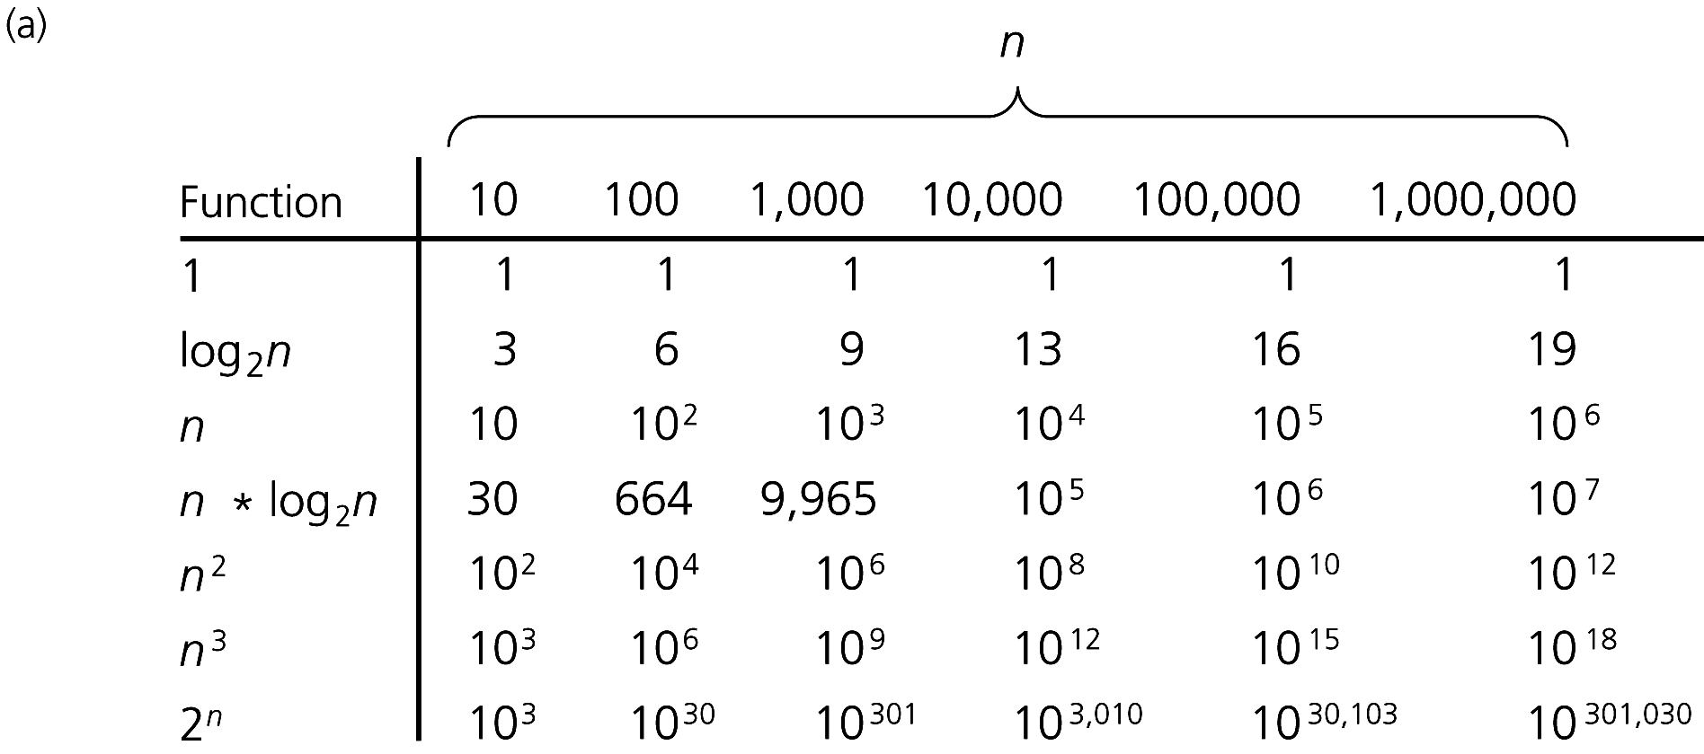
Order-of-Magnitude Analysis and Big O Notation
Figure 9-3a A comparison of growth-rate functions: (a) in tabular form

Slide 28
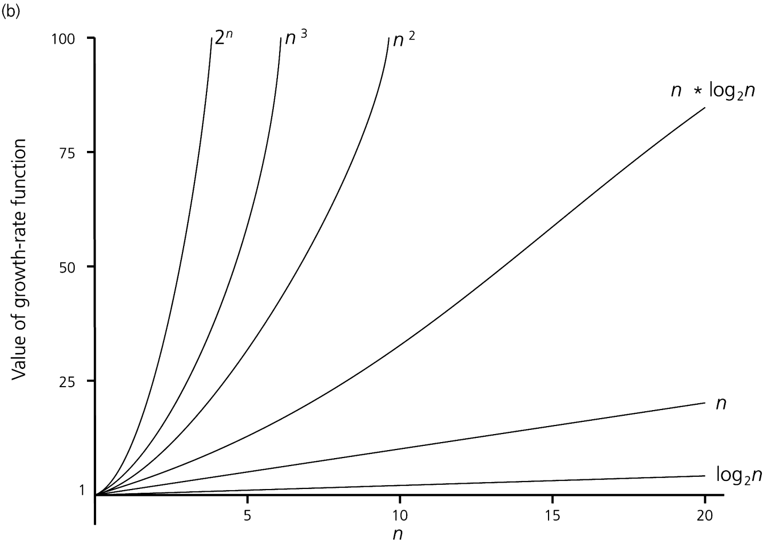
Order-of-Magnitude Analysis and Big O Notation
Figure 9-3b A comparison of growth-rate functions: (b) in graphical form

Slide 29
Big-O Analysis in General
To determine the time complexity of an algorithm:
Express the amount of work done as a sum f₁(n) + f₂(n) + … + f_{k}(n)
Identify the dominant term: the f_{i} such that f_{j} is O(f_{i}) and for k different from j
f_{k} (n) < f_{j} (n) (for all sufficiently large n)
Then the time complexity is O(f_{i})

Slide 30
Big-O Analysis in General
Examples of dominant terms:
n dominates log₂(n)
n*log₂(n) dominates n
n² dominates n*log₂(n)
n^{m} dominates n^{k} when m > k
a^{n} dominates n^{m} for any a > 1 and m >= 0
That is, log₂(n) < n < n*log₂(n) < n² < … < n^{m} < a^{n} for a >= 1 and m > 2

Slide 31
Intractable problems
A problem is said to be intractable if solving it by computer is impractical
Example: Algorithms with time complexity O(2^{n}) take too long to solve even for moderate values of n; a machine that executes 100 million instructions per second can execute 2⁶⁰ instructions in about 365 years

Slide 32
STOP

Slide 33
Constant Time Complexity
Algorithms whose solutions are independent of the size of the problem’s inputs are said to have constant time complexity
Constant time complexity is denoted as O(1)

Slide 34
Time Complexities for Data Structure Operations
Many operations on the data structures we’ve seen so far are clearly O(1): retrieving the size, testing emptiness, etc
We can often recognize the time complexity of an operation that modifies the data structure without a formal proof

Slide 35
Time Complexities for Array Operations
Array elements are stored contiguously in memory, so the time required to compute the memory address of an array element arr[k] is independent of the array’s size: It’s the start address of arr plus k * (size of an individual element)
So, storing and retrieving array elements are O(1) operations

Slide 36
Time Complexities for Array-Based List Operations
Assume an n-element List:
insert operation is O(n) in the worst case, which is adding to the first location: all n elements in the array have to be shifted one place to the right before the new element can be added

Slide 37
Time Complexities for Array-Based List Operations
Inserting into a full List is also O(n):
replaceContainer copies array contents from the old array to a new one (O(n))
All other activies (allocating the new array, deleting the old one, etc) are O(1)
Replacing the array and then inserting at the beginning requires O(n) + O(n) time, which is O(n)

Slide 38
Time Complexities for Array-Based List Operations
remove operation is O(n) in the worst case, which is removing from the first location: n-1 array elements must be shifted one place left
retrieve, replace, and swap operations are O(1): array indexing allows direct access to an array location, independent of the array size; no shifting occurs
find is O(n) because the entire list has to be searched in the worst case

Slide 39
Time Complexities for Linked List Operations
Singly linked list with n nodes:
addHead, removeHead, and retrieveHead are all O(1)
addTail and retrieveTail are O(1) provided that the implementation has a tail reference; otherwise, they’re O(n)
removeTail is O(n): need to traverse to the second-last node so that its reference can be reset to NULL

Slide 40
Time Complexities for Linked List Operations
Singly linked list with n nodes (cont’d):
Operations to access an item by position (add , retrieve, remove(unsigned int k), replace) are O(n): need to traverse the whole list in the worst case
Operations to access an item by its value (find, remove(Item item)) are O(n) for the same reason

Slide 41
Time Complexities for Linked List Operations
Doubly-linked list with n nodes:
Same as for singly-linked lists, except that all head and tail operations, including removeTail, are O(1)
Ordered linked list with n nodes:
Comparable operations to those found in the linked list class have the same time complexities
add(Item item) operation is O(n): may have to traverse the whole list

Slide 42
Time Complexities for Stack Operations
Stack using an underlying array:
All operations are O(1), provided that the top of the stack is always at the highest index currently in use: no shifting required
Stack using an array-based list:
All operations O(1), provided that the tail of the list is the top of the stack
Exception: push is O(n) if the array size has to double

Slide 43
Time Complexities for Stack Operations
Stack using an underlying linked list:
All operations are, or should be, O(1)
Top of stack is the head of the linked list
If a doubly-linked list with a tail pointer is used, the top of the stack can be the tail of the list

Slide 44
Time Complexities for Queue Operations
Queue using an underlying array-based list:
peek is O(1)
enqueue is O(1) unless the array size has to be increased (in which case it’s O(n))
dequeue is O(n) : all the remaining elements have to be shifted

Slide 45
Time Complexities for Queue Operations
Queue using an underlying linked list:
As long as we have both a head and a tail pointer in the linked list, all operations are O(1)
important: enqueue() should use addTail() dequeue() should use removeHead()
Why not the other way around?
No need for the list to be doubly-linked

Slide 46
Time Complexities for Queue Operations
Circular queue using an underlying array:
All operations are O(1)
If we revise the code so that the queue can be arbitrarily large, enqueue is O(n) on those occasions when the underlying array has to be replaced

Slide 47
Time Complexities for OrderedList Operations
OrderedList with array-based m_container:
Our implementation of insert(item) (see slide 10-12) uses “linear search” that traverses the list from its beginning until the right spot for the new item is found – linear complexity O(n)
Operation remove(int pos) is also O(n) since items have to be shifted in the array

Slide 48
Basic Search Algorithms and their Complexity Analysis

Slide 49
Linear Search: Example 1
The problem: Search an array a of size n to determine whether the array contains the value key; return index if found, -1 if not found
Set k to 0.
While (k < n) and (a[k] is not key)
Add 1 to k.
If k == n Return –1.
Return k.

Slide 50
Analysis of Linear Search
Total amount of work done:
Before loop: a constant amount a
Each time through loop: 2 comparisons, an and operation, and an addition: a constant amount of work b
After loop: a constant amount c
In worst case, we examine all n array locations, so T(n) = a +b*n + c = b*n + d, where d = a+c, and time complexity is O(n)

Slide 51
Analysis of Linear Search
Simpler (less formal) analysis:
Note that work done before and after loop is independent of n, and work done during a single execution of loop is independent of n
In worst case, loop will be executed n times, so amount of work done is proportional to n, and algorithm is O(n)

Slide 52
Analysis of Linear Search
Average case for a successful search:
Probability of key being found at index k is 1 in n for each value of k
Add up the amount of work done in each case, and divide by total number of cases:
((a*1+d) + (a*2+d) + (a*3+d) + … + (a*n+d))/n
= (n*d + a*(1+2+3+ … +n))/n
= n*d/n + a*(n*(n+1)/2)/n = d + a*n/2 + a/2 = (a/2)*n + e, where constant e=d+a/2, so expected case is also O(n)

Slide 53
Analysis of Linear Search
Simpler approach to expected case:
Add up the number of times the loop is executed in each of the n cases, and divide by the number of cases n
(1+2+3+ … +(n-1)+n)/n = (n*(n+1)/2)/n = n/2 + 1/2; algorithm is therefore O(n)

Slide 54
Linear Search for LinkedList
Linear search can be also done for LinkedList
exercise: write code for function
Complexity of function find(key) for class LinkedList should also be O(n)
template <class Item> template <class Equality>
int LinkedList<Item>::find(Item key) const { …}

Slide 55
Binary Search (on sorted arrays)
General case: search a sorted array a of size n looking for the value key
Divide and conquer approach:
Compute the middle index mid of the array
If key is found at mid, we’re done
Otherwise repeat the approach on the half of the array that might still contain key
etc…

Slide 56
Example: Binary Search For Ordered List
int binarySearch(m_container, key) {
int first = 1, last = m_container.getLength();
while (first <= last) { // start of while loop
int mid = (first+last)/2;
Item val = retrieve(mid);
if (key < val) last = mid-1;
else if (key > val) first = mid+1;
else return mid;
} // end of while loop
return –1;
}

Slide 57
Analysis of Binary Search
The amount of work done before and after the loop is a constant, and independent of n
The amount of work done during a single execution of the loop is constant
Time complexity will therefore be proportional to number of times the loop is executed, so that’s what we’ll analyze

Slide 58
Analysis of Binary Search
Worst case: key is not found in the array
Each time through the loop, at least half of the remaining locations are rejected:
After first time through, <= n/2 remain
After second time through, <= n/4 remain
After third time through, <= n/8 remain
After k^{th} time through, <= n/2^{k} remain

Slide 59
Analysis of Binary Search
Suppose in the worst case that maximum number of times through the loop is k; we must express k in terms of n
Exit the do..while loop when number of remaining possible locations is less than 1 (that is, when first > last): this means that n/2^{k} < 1

Slide 60
Analysis of Binary Search
Also, n/2^{k-1} >=1; otherwise, looping would have stopped after k-1 iterations
Combining the two inequalities, we get:
n/2^{k} < 1 <= n/2 ^{k-1}
Invert and multiply through by n to get:
2^{k} > n >= 2 ^{k-1}

Slide 61
Analysis of Binary Search
Next, take base-2 logarithms to get:
k > log₂(n) >= k-1
Which is equivalent to:
log₂(n) < k <= log₂(n) + 1
Thus, binary search algorithm is O(log₂(n)) in terms of the number of array locations examined

Slide 62
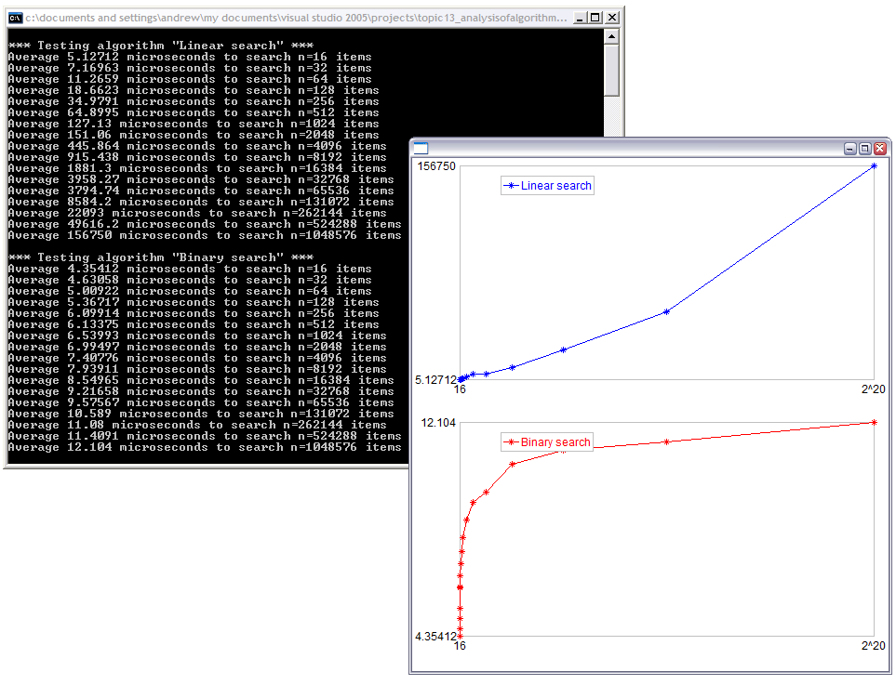
Binary vs. Liner Search
t
n
t
search for one
out of n
ordered integers
n
see demo: www.csd.uwo.ca/courses/CS1037a/demos.html

Slide 63
Basic Sorting Algorithms and their Complexity Analysis

Slide 64
Analysis: Selection Sort Algorithm
Assume we have an unsorted collection of n elements in an array or list called container; elements are either of a simple type, or are pointers to data
Assume that the elements can be compared in size ( <, >, ==, etc)
Sorting will take place “in place” in container

Slide 65
Analysis: Selection Sort Algorithm
- sorted portion of the list
- minimum element in unsorted portion
Find smallest element in unsorted portion of container
6
4
2
9
3
Interchange the smallest element with the one at the front of the unsorted portion
2
4
6
9
3
Find smallest element in unsorted portion of container
2
4
6
9
3
2
3
6
9
4
Interchange the smallest element with the one at the front of the unsorted portion

Slide 66
Analysis: Selection Sort Algorithm
- sorted portion of the list
- minimum element in unsorted portion
2
3
6
9
4
Find smallest element in unsorted portion of container
Interchange the smallest element with the one at the front of the unsorted portion
2
3
4
9
6
2
3
4
9
6
Find smallest element in unsorted portion of container
2
3
4
6
9
Interchange the smallest element with the one at the front of the unsorted portion
After n-1 repetitions of this process, the last item has automatically fallen into place

Slide 67
Selection Sort for (array-based) List
// A new member function for class List<Item>, needs additional template parameter
void selectionSort(list,items) {
unsigned int minSoFar, i, k;
for (i = 1; i < items; i++ ) { // ‘unsorted’ part starts at given ‘i’
minSoFar = i;
for (k = i+1; k <= items; k++) // searching for min Item inside ‘unsorted’
if (list[k]<list[minSoFar]) minSoFar = k;
swap( list[i], list[minSoFar]);
} // end of for-i loop
}

Slide 68
Analysis: Selection Sort Algorithm
We’ll determine the time complexity for selection sort by counting the number of data items examined in sorting an n-item array or list
Outer loop is executed n-1 times
Each time through the outer loop, one more item is sorted into position

Slide 69
Analysis: Selection Sort Algorithm
On the k^{th} time through the outer loop:
Sorted portion of container holds k-1 items initially, and unsorted portion holds n-k+1
Position of the first of these is saved in minSoFar; data object is not examined
In the inner loop, the remaining n-k items are compared to the one at minSoFar to decide if minSoFar has to be reset

Slide 70
Analysis: Selection Sort Algorithm
2 data objects are examined each time through the inner loop
So, in total, 2*(n-k) data objects are examined by the inner loop during the k^{th} pass through the outer loop
Two elements may be switched following the inner loop, but the data values aren’t examined (compared)

Slide 71
Analysis: Selection Sort Algorithm
Overall, on the k^{th} time through the outer loop, 2*(n-k) objects are examined
But k ranges from 1 to n-1 (the number of times through the outer loop)
Total number of elements examined is:
T(n) = 2*(n-1) + 2*(n-2) + 2*(n-3) + … + 2*(n-(n-2)) + 2*(n-(n-1))
= 2*((n-1) + (n-2) + (n-3) + … + 2 + 1) (or 2*(sum of first n-1 ints)
= 2*((n-1)*n)/2) = n² – n, so the algorithm is O(n²)

Slide 72
Analysis: Selection Sort Algorithm
This analysis works for both arrays and array-based lists, provided that, in the list implementation, we either directly access array m_container, or use retrieve and replace operations (O(1) operations) rather than insert and remove (O(n) operations)

Slide 73
Analysis: Selection Sort Algorithm
The algorithm has deterministic complexity
the number of operations does not depend on specific items, it depends only on the number of items
all possible instances of the problem (“best case”, “worst case”, “average case”) give the same number of operations T(n)=n²–n=O(n²)

Slide 74
Radix Sort
Sorts objects based on some key value found within the object
Most often used when keys are strings of the same length, or positive integers with the same number of digits
Uses queues; does not sort “in place”
Other names: postal, bin, bucket sort

Slide 75
Radix Sort Algorithm
Suppose keys are k-digit integers
Radix sort uses an array of 10 queues, one for each digit 0 through 9
Each object is placed into the queue whose index is the least significant digit (the 1’s digit) of the object’s key
Objects are then dequeued from these 10 queues, in order 0 through 9, and put back in the original queue/list/array container; they’re sorted by the last digit of the key

Slide 76
Radix Sort Algorithm
Process is repeated, this time using the 10’s digit instead of the 1’s digit; values are now sorted by last two digits of the key
Keep repeating, using the 100’s digit, then the 1000’s digit, then the 10000’s digit, …
Stop after using the most significant (10^{n-1}’s ) digit
Objects are now in order in original container

Slide 77
Algorithm: Radix Sort
Assume n items to be sorted, k digits per key, and t possible values
for a digit of a key, 0 through t-1. (k and t are constants.)
For each of the k digits in a key:
While the queue q is not empty:
Dequeue an element e from q.
Isolate the k^{th} digit from the right in the key for e; call it d.
Enqueue e in the d^{th} queue in the array of queues arr.
For each of the t queues in arr:
While arr[t-1] is not empty
Dequeue an element from arr[t-1] and enqueue it in q.

Slide 78
Radix Sort Example
Suppose keys are 4-digit numbers using only the digits 0, 1, 2 and 3, and that we wish to sort the following queue of objects whose keys are shown:
3023
1030
2222
1322
3100
1133
2310

Slide 79
Radix Sort Example
3023
1030
2222
1322
3100
1133
2310
First pass: while the queue above is not empty, dequeue an item and add it into one of the queues below based on the item’s last digit
0
.
1030
3100
2310
1
Array of queues after the first pass
2
2222
1322
3
3023
1133
Then, items are moved back to the original queue (first all items from the top queue, then from the 2nd, 3rd, and the bottom one):
1030
3100
2310
2222
1322
3023
1133

Slide 80
Radix Sort Example
1030
3100
2310
2222
1322
3023
1133
Second pass: while the queue above is not empty, dequeue an item and add it into one of the queues below based on the item’s 2nd last digit
0
3100
1
2310
Array of queues after the second pass
2
2222
1322
3023
3
1030
1133
Then, items are moved back to the original queue (first all items from the top queue, then from the 2nd, 3rd, and the bottom one):
3100
2310
2222
1322
3023
1030
1133

Slide 81
Radix Sort Example
3100
2310
2222
1322
3023
1030
1133
First pass: while the queue above is not empty, dequeue an item and add it into one of the queues below based on the item’s 3rd last digit
0
3023
1030
1
3100
1133
Array of queues after the third pass
2
2222
3
2310
1322
Then, items are moved back to the original queue (first all items from the top queue, then from the 2nd, 3rd, and the bottom one):
3023
1030
3100
1133
2222
2310
1322

Slide 82
Radix Sort Example
3023
1030
3100
1133
2222
2310
1322
First pass: while the queue above is not empty, dequeue an item and add it into one of the queues below based on the item’s first digit
0
.
1030
1133
1322
1
Array of queues after the fourth pass
2
2222
2310
3
3023
3100
Then, items are moved back to the original queue (first all items from the top queue, then from the 2nd, 3rd, and the bottom one): NOW IN ORDER
1030
1133
1322
2222
2310
3023
3100

Slide 83
Analysis: Radix Sort
We’ll count the total number of enqueue and dequeue operations
Each time through the outer for loop:
In the while loop: n elements are dequeued from q and enqueued somewhere in arr: 2*n operations
In the inner for loop: a total of n elements are dequeued from queues in arr and enqueued in q: 2*n operations

Slide 84
Analysis: Radix Sort
So, we perform 4*n enqueue and dequeue operations each time through the outer loop
Outer for loop is executed k times, so we have 4*k*n enqueue and dequeue operations altogether
But k is a constant, so the time complexity for radix sort is O(n)
COMMENT: If the maximum number of digits in each number k is considered as a parameter describing problem input, then complexity can be written in general as O(n*k) or O(n*log(max_val))

