Slide 1
CSc 235: Stacks & Frames Allocation of Automatic Variables
Author:
Dr. Spiegel

Slide 2
Topics
Stack Frame (Activation Record)
SPARC vs x86
Automatic Variables
Local declarations
Arrays
One-dimensional
Multi-dimensional (nested)
Multi-level
Structures
Allocation
Access
Alignment

Slide 3
Program Address Space
Low memory
Code Section
Code
Static variables
OS information
Heap Section
Dynamic variables
Stack Section
Automatic variables
High memory

Slide 4
Stack section
Contains automatic variables of the functions
Contains frame information for each call of a function
Stack grows from high memory to low memory
Frames are allocated backwards in memory
The stack pointer is at the beginning of the frame, at its lowest address.
In x86, local variables are allocated at the beginning of the frame
The stack pointer is moved backwards to make room
Really a stack of Frames

Slide 5
Stack View
Stack Top %sp ->
Low memory
Function Frame 3
Function Frame 2
Function Frame 1
High memory
Main Frame

Slide 6
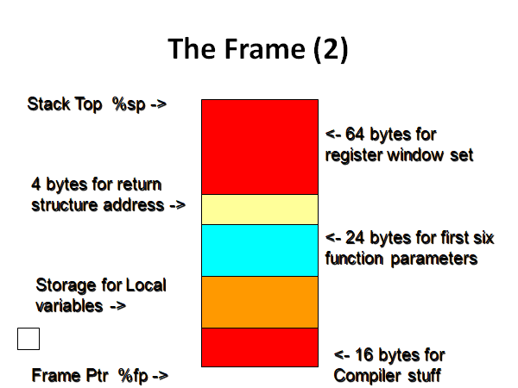
SPARC Stack Frame

Slide 7
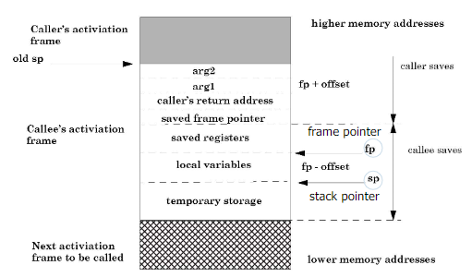
Typical x86 Stack Frame

Slide 8
SPARC vs x86
Register Set
SPARC has 128 general use 32-bit registers
Each function has 24 of those registers available
8 shared with caller and 8 with callee
X86 has no similar mechanism
16 general purpose registers
Shared by all functions
Preservation is by saving in frame
Stack frame has room set aside for 16 registers
Parameter Passing
SPARC has area for parameters in frame
X86 assumes pass is always by register if less than six arguments

Slide 9
SPARC vs x86
Automatic Variable Area
Variable size in SPARC
Not automatically accounted for in x86
Allocate memory
Extend frame
Must be word (16 bit) divisible
Return area in SPARC frame has no x86 Equivalent
Compiler Stuff area in SPARC has no equivalent
Maintaining PC for each call of a function
Accomplished by caller pushing the return address before the call

Slide 10
Automatic (local) Variables in x86
To allocate space for local variables
Subtract required space from %rsp
Must be next multiple of 16 to keep stack properly aligned
Designate space within allocated memory for each variable
Must be aligned
Best to have some sort of legend
Offset forward from %rsp
Good reason to use m4 preprocessor
To access a local variable
The address is the offset from the stack pointer
Recorded in your legend
Use of define()

Slide 11
Automatic Variables Example
AddXY.m
Uses define() to explicitly name offsets and registers
Allocates space on run-time stack for two integers
Must allocate 16 bytes to keep stack aligned
Unaligned access results in a bus error
Only need four bytes per integer
Reads directly to stack frame
Use of define () complicates instructions for loading variables
Can’t use leaq nor displacement prefix
AddXY_NoDefine.s
Doesn’t use define()
MUCH harder to follow

Slide 12
Array Storage
Consider an array A in C defined as follows:
some_type A[array_size]
A compiler would need to set aside enough storage for the entire array. The following formula is used by the compiler:
bytes_needed = array_size * size of some_type

Slide 13
Examples
Assume automatic storage is desired
int a[10] requires 40 bytes
double f[25] requires 200 bytes
char ch[25] usually requires 28 bytes (why?)
customertype customers[100] requires 8000 bytes assuming a customertype needs 80 bytes.

Slide 14
Array Addressing
Once stored, how is the address of a component computed?
Depends on how the elements are stored:
big-endian little-endian
Big-endian stores the low index in lower memory and the higher indices in high memory
Little-endian stores the low index in high memory and the high indices in low memory
Comes from the way numbers are stored

Slide 15
Big-endian vs Little-endian Storing 0x12345678
Low memory
12
34
56
78
78
56
34
12
Big-Endian
Little-Endian
High memory

Slide 16
Big-endian vs Little-endian
A[0]
A[1]
A[size-1]
A[size-1]
A[1]
A[0]
Low memory
High memory
Big-Endian
Little-Endian

Slide 17
Big Endian Array Storage
Most compilers store arrays in big endian order
Address of a component A[I] is then computed using the following formula:
address(A[i]) = address(A) +
i*(size of component)
We are writing in assembler so we can choose big or little endian

Slide 18
Computing Address of A[i]
Address of A
A[0]
A[1]
A[I]
A[size-1]
i components
Address of A[I]
Size of 1 component

Slide 19
Array Storage
Setting aside enough storage for the entire array
Must also maintain stack alignment
Each frame must be word addressable
%rsp MUST be divisible by 16
The formula used by the compiler is modified:
Bytes needed is next multiple of 16 past(local variables’ size)
Example
ArrayEx1.s

Slide 20
Structures
A structure is similar to a class, where all data members are public. In C structures do not have member functions.
The data members of a structure are stored as a composite unit. Each member has a address (offset) measured from the beginning of the structure

Slide 21
Example
Consider the customer structure defined below:
typedef struct
{ char name[24];
int age;
int salary;
} customer_type;
customer_type customer;

Slide 22
Addressing Structure Components
To address a component of a structure, we use the formula:
addr(component) = addr(structure)
+ offset of component from beginning of
structure
It is customary to use Big Endian storage for structures, so the offset is positive.

Slide 23
Customer Struct
Customer
Low memory
Offset of name: 0
name
age
salary
Offset of age: 24
Offset of salary: 28
High memory
Example
StructEx.m

Slide 24
Structure Containing an Array
r
struct rec {
int a[4];
size_t i;
struct rec *next;
};
a
i
next
0
16
24
32
Structure represented as block of memory
Big enough to hold all of the fields
Compiler determines overall size + positions of fields
Machine-level program has no understanding of the structures in the source code
Fields ordered according to declaration
Even if another ordering could yield a more compact representation
Only when the code is a result of compilation

Slide 25
Structures & Alignment
Unaligned Data
Aligned Data
Primitive data type requires K bytes
Address of each element must be multiple of K
struct S1 {
char c;
int i[2];
double v;
} *p;
c
i[0]
i[1]
v
p
p+1
p+5
p+9
p+17
c
3 bytes
i[0]
i[1]
4 bytes
v
p+0
p+4
p+8
p+16
p+24
Multiple of 4
Multiple of 8
Multiple of 8
Multiple of 8

Slide 26
Specific Cases of Alignment (x86-64)
1 byte: char, …
no restrictions on address
2 bytes: short, …
lowest 1 bit of address must be 02
4 bytes: int, float, …
lowest 2 bits of address must be 002
8 bytes: double, long, char *, …
lowest 3 bits of address must be 0002
16 bytes: long double (GCC on Linux)
lowest 4 bits of address must be 00002

Slide 27
Satisfying Alignment with Structures
Within structure:
Must satisfy each element’s alignment requirement
Overall structure placement
Each structure has alignment requirement K
K = Largest alignment of any element
Initial address & structure length must be multiples of K
Example:
K = 8, due to double element
struct S1 {
char c;
int i[2];
double v;
} *p;
c
3 bytes
i[0]
i[1]
4 bytes
v
p+0
p+4
p+8
p+16
p+24
Multiple of 4
Multiple of 8
Multiple of 8
Multiple of 8

Slide 28
Meeting Overall Alignment Requirement
For largest alignment requirement K
Overall structure must be multiple of K
struct S2 {
double v;
int i[2];
char c;
} *p;
 | v |  |  |  |  |  |  | i[0] |  |  |  | i[1] |  |  |  | c | 7 bytes
p+0 |  |  |  |  |  |  | p+8 |  |  |  |  |  |  |  | p+16 |  |  |  |  |  |  |  | p+24
Multiple of K=8

Slide 29
Arrays of Structures
struct S2 {
double v;
int i[2];
char c;
} a[10];
Overall structure length multiple of K
Satisfy alignment requirement for every element
 | a[0] |  |  |  |  | a[1] |  |  |  |  | a[2] |  |  |  |  | • • •
a+0 |  |  |  |  | a+24 |  |  |  |  | a+48 |  |  |  |  | a+72
Example
ArrayOfStruct.m
 | v |  |  |  |  |  |  | i[0] |  |  |  | i[1] |  |  |  | c | 7 bytes
a+24 |  |  |  |  |  |  | a+32 |  |  |  |  |  |  |  | a+40 |  |  |  |  |  |  |  | a+48

