Slide 1
A DISTRIBUTED MODEL-VIEW-CONTROLLER DESIGN PATTERN FOR A GRAPHICAL REMOTE CONTROL OF A MULTI-USER APPLICATION (PACISE 2020 paper)
Dale E. Parson, https://faculty.kutztown.edu/parson, April 10, 2021
Department of Computer Science & Information Technology
Kutztown University of PA
2021 Conference of PA Computer & Information Science Educators

Slide 2
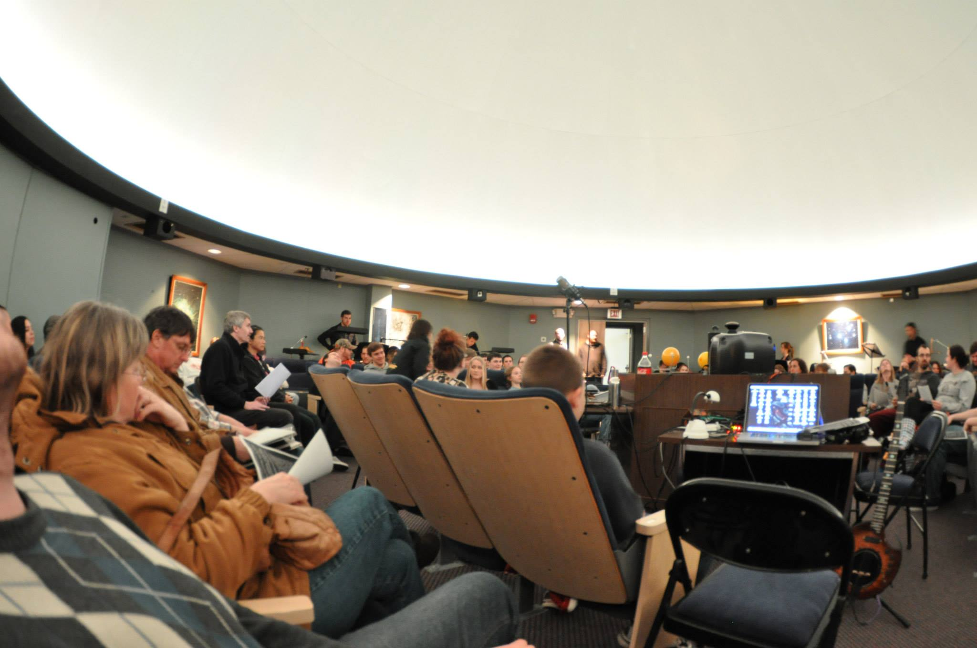
Background: Students & I do a lot of multimedia programming for the planetarium

Slide 3
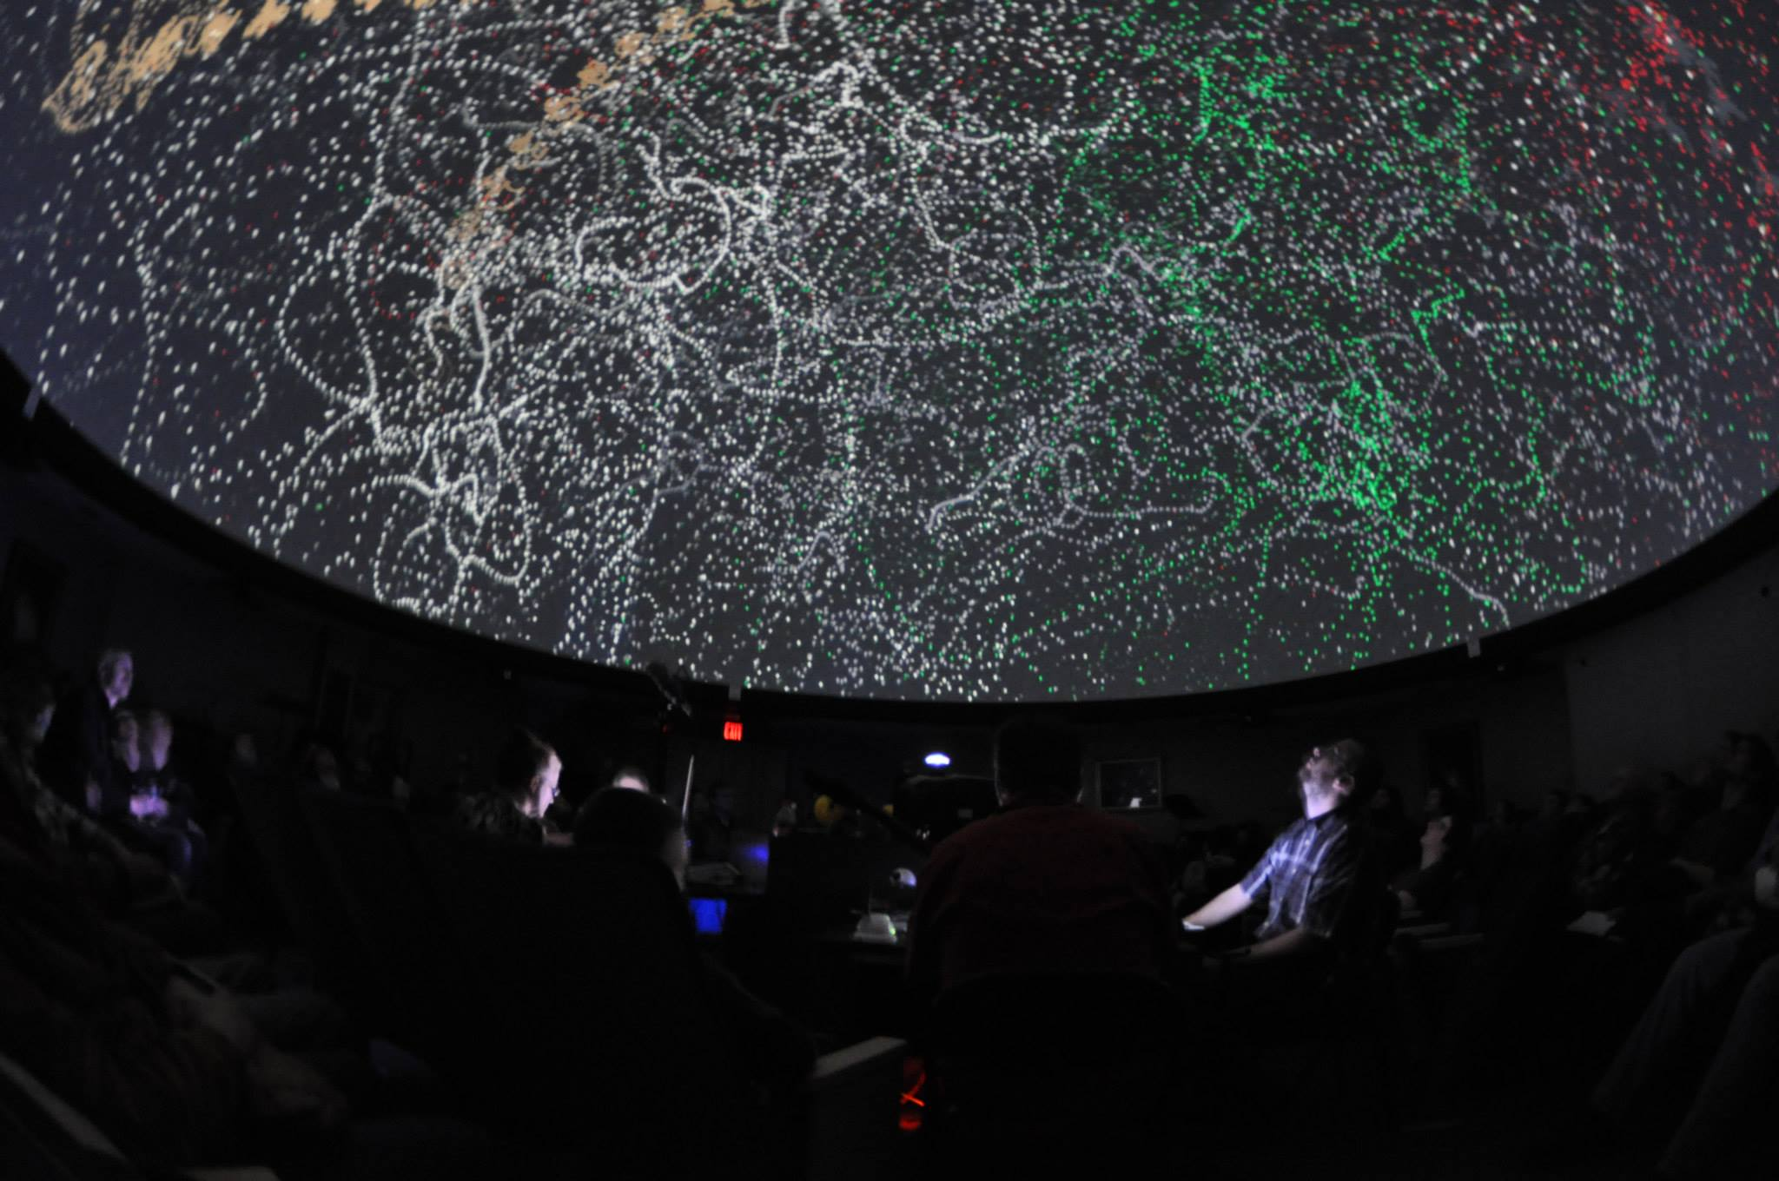
Audio signal visualizations are past projects

Slide 4
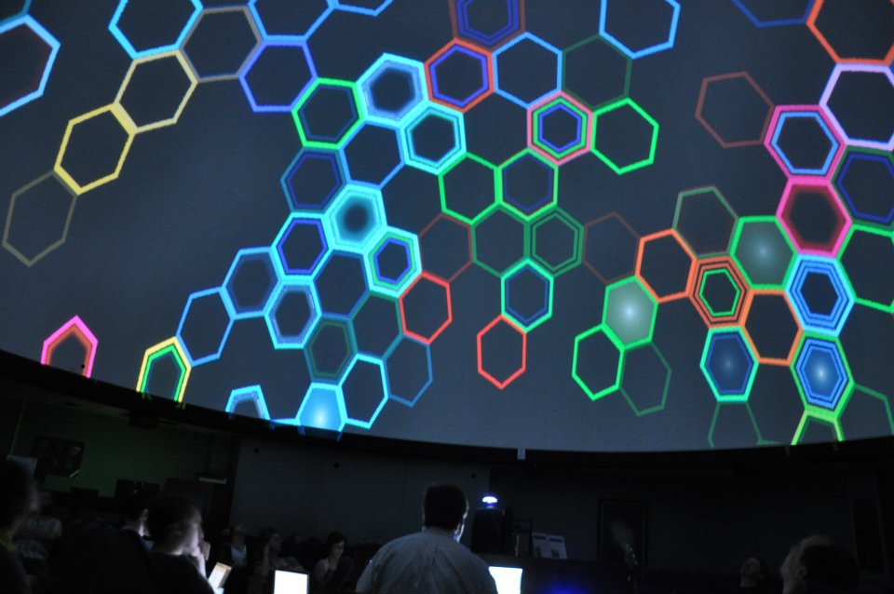
Generating music from graphical games are additional past projects

Slide 5
A graphical-to-MIDI musical instrument
Processing is a Java framework for multimedia programming.
https://processing.org/
We have a mix of CS, IT, and Digital Art students at Kutztown.
Musical Instrument Digital Interface via javax.sound.midi
Java library comes with ~127 built-in software synthesizers.
Architecture supports driving custom external synths via buses.
High-level goal is to integrate graphical play with musical performance.

Slide 6
Sophomore+ level project goal
Note’s color corresponds to its positional interval in a scale.
Scale is cyclic, e.g., do re me fa so la ti (do …).
Brightness (opacity) corresponds to MIDI velocity (volume).
Distance from center of circle (dome) also corresponds to velocity.
Angular position around the dome corresponds to octave.
Students’ first assignment included:
Arrange graphical instrument “keys” according to interval, velocity, and octave using polar geometry (% of radius, degrees around circle).
Find graphical “key” closest to a mouse press or release using Cartesian distance and invoke its note-sounding function to generate MIDI data.

Slide 7
Randomly arranged notes in handout code

Slide 8
Notes arranged using polar geometry
Notes:
Play CSC220F19MIDIassn3parson

Slide 9
Model-View-Controller (MVC) Pattern
Notes:
Play CSC220F19MIDIassn3parson

Slide 10
Stand-alone Processing instrument MVC
Notes:
Play CSC220F19MIDIassn3parson

Slide 11
Stand-alone Processing instrument functions
setup() initializes MIDI output API and state variables
draw() runs at framerate (10 X per second here) to redraw screen
rect(), ellipse(), line(), image(), shape(), etc. draw objects
translate(), rotate() and scale() position, orient, and size objects
Controller’s mousePressed() and keyPressed() functions capture user input events and update the state of the musical objects (Model)
Musician and Note objects in the Model send noteon, noteoff, instrument changes, and FX changes to aural View.
They also send graphical function calls to the graphical View.
Notes:
Play CSC220F19MIDIassn3parson

Slide 12
Strategy for distributing client-server MVC Client Side
Clone the identical stand-alone code.
Controller_{client} mousePressed() invokes functions in Model_{client} Musician and Note objects runs as before.
These Model_{client} objects send graphical function calls to the graphical View_{client} as in the stand-alone implementation.
These Model_{client} objects send MIDI noteon, noteoff, and FX changes to Open Sound Control OSC/UDP sender routed to the server.
Code structure is the same as stand-alone except that MIDI data to aural View is now routed over OSC/UDP datagrams.
Notes:
Play CSC220F19MIDIassn3parson

Slide 13
Distributed client-server MCV – client
Notes:
Play CSC220F19MIDIassn3parson

Slide 14
Strategy for distributing client-server MVC Client Side
Clone the identical stand-alone code.
Controller_{server} mousePressed() invokes functions in Model_{server} Musician and Note objects runs as before.
oscEvent() handler runs in parallel with Controller_{server}, packaging data from datagram and sending it to Musician objects in the Model_{server}
oscEvent() handler runs in its own thread, requiring thread-safe immutable data container & java.util.concurrent Queue for sending received data containers to Model_{server}. draw() periodically calls processOSCevents() to poll the thread-safe Queue.
These Model_{server} objects send graphical function calls to the graphical View_{server} as in the stand-alone implementation.
Code structure is the same as stand-alone except that oscEvent() is added as a new source of input in the Controller_{server}.
Notes:
Play CSC220F19MIDIassn3parson

Slide 15
Distributed client-server MCV – client
Notes:
Play CSC220F19MIDIassn3parson

Slide 16
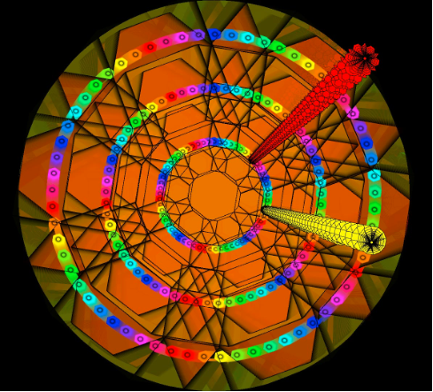
Server display example & a demo
Notes:
Play CSC220F19MIDIassn3parson, CSC480S20MIDIassn1ServerParson, CSC220F19MIDIassn3parson, CSC480S20Androidassn1bClientParson

Slide 17
Distributed client-server MVC implementation considerations
Keep the client side graphics as simple as possible for responsiveness on an Android tablet – 2D graphics, simple textual connection setup.
Add client features for sending instrument (MIDI channel) changes and programming note loops into clients.
Avoid any server-to-client synchronization after initial “connection” acknowledgement to avoid cluttering the LAN and complicating the design.
Add server features such as 3D graphics & support for concurrent clients.
Notes:
Play CSC220F19MIDIassn3parson

Slide 18
Conclusions
There is nothing that having a 55-foot diameter hemisphere for debugging & performing student multimedia visual-musical instruments.
Instructor sketches out the design & implements the main parts of the framework.
Students fill in missing parts and add custom features such as ambitious graphical and MIDI effects.
Multimedia programming from the freshman through graduate levels has taken off at Kutztown University.
Notes:
Play CSC220F19MIDIassn3parson

