Slide 1
Analysis on Charities’ Reputability
Tyler Stoney

Slide 2
Background
Charities are businesses
Not all businesses are reputable
∴ Some charities may not be reputable
Clean dataset from Kaggle, no solutions, new analysis
Scraped from a site who collects these statistics on charities in the US

Slide 3
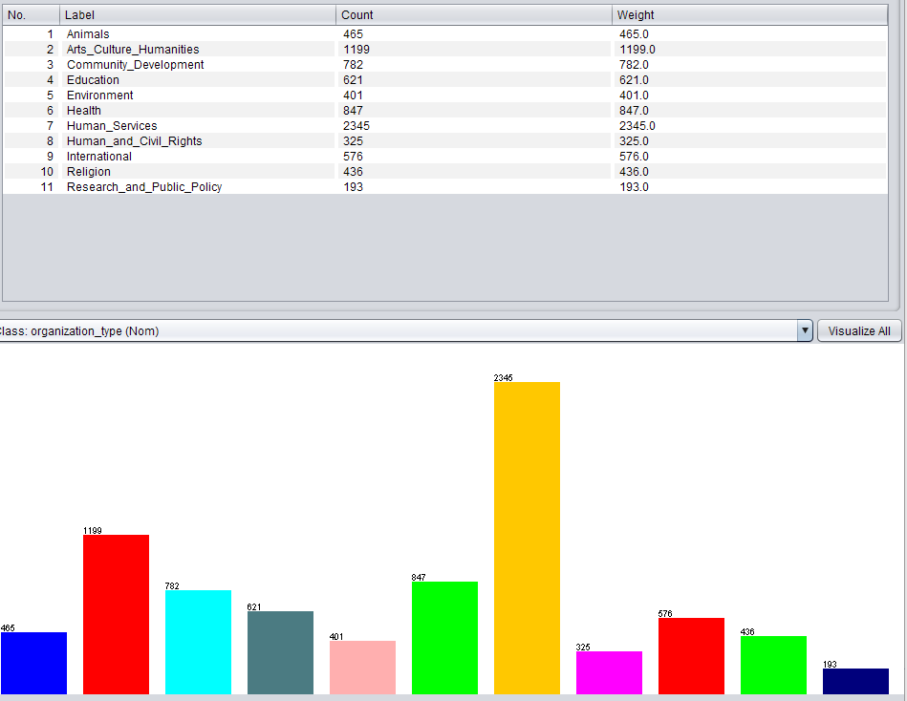
Attributes of Note
Accountability_score
Financial_score
Overall_score
Organization_type ← primary target

Slide 4
What Am I Looking For?
Classify organization’s type (Health, animal, religious, etc) based on performance
Can performance be used to stereotype the organization’s purpose or vice-versa

Slide 5
First Steps
J48
Trees performant with redundancy
First tree, no modifications to set, massive, little payout.
10-fold cross CCI: 25%, kappa 0.12
15 percent split CCI: 22%, kappa 0.089
11 organization types, so random guess = 1/11 = ~ 9%

Slide 6
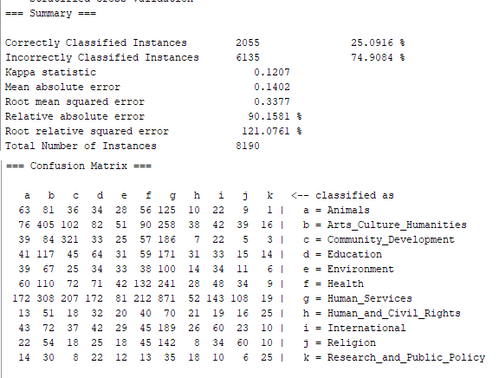
First Steps – J48

Slide 7
Inter-instance correlations?
Long story short, no.
IBk, K* were not performant; ran worse than J48.
J48 is decision tree making correlations across the dataset
These instances are independent

Slide 8
Classify attributes
“Select Attributes” tab in Weka
Ranker + GainRatioAttributeEvaluator
Information gain ratio: biases against high numbers of distinct values

Slide 9
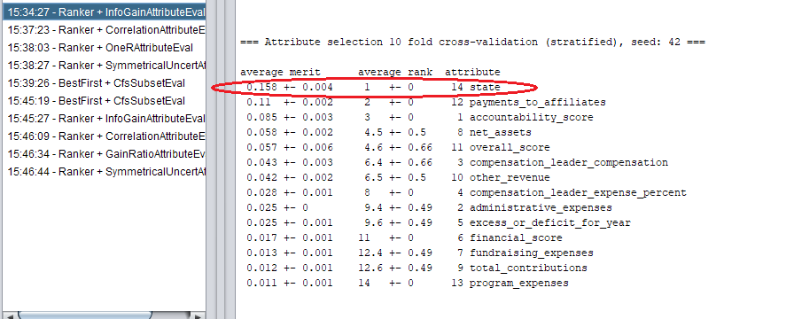
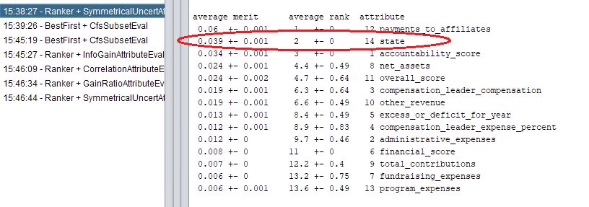
The “State” of My Attribute Classification

Slide 10
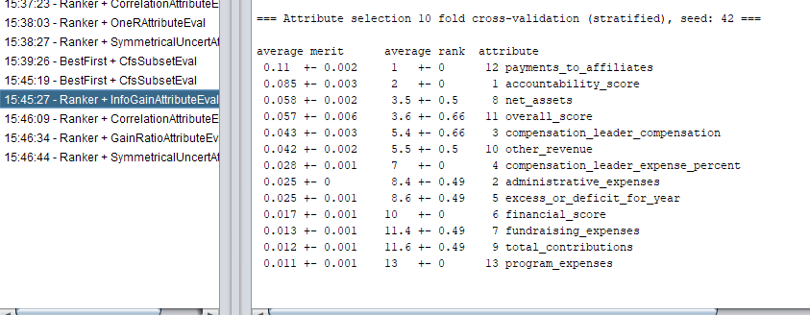
The “State” of My Attribute Classification

Slide 11
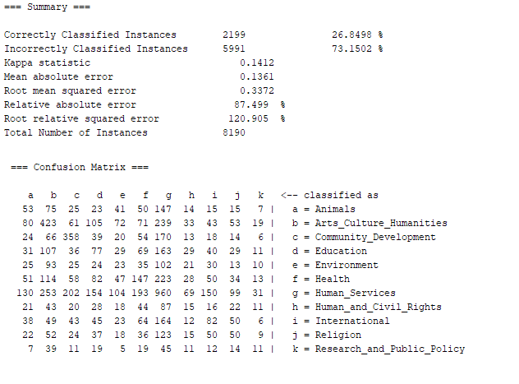
Immediate results

Slide 12
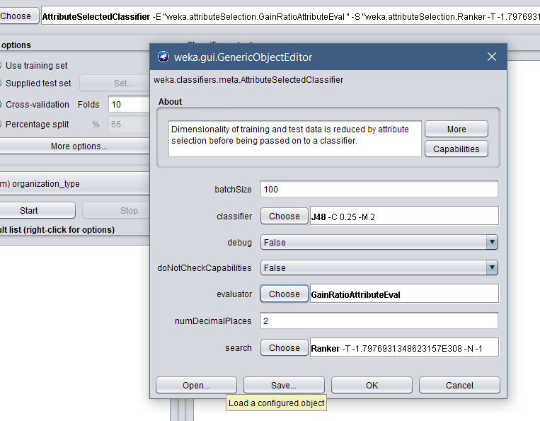
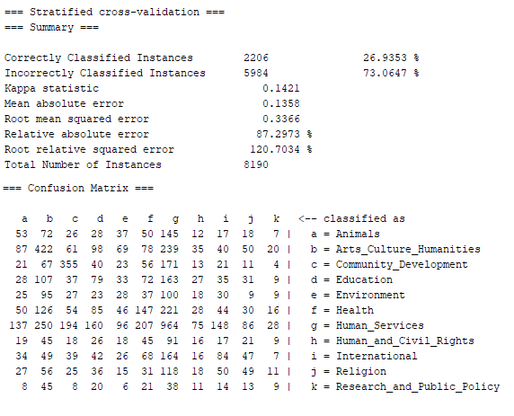
What’s holding this set back?

Slide 13
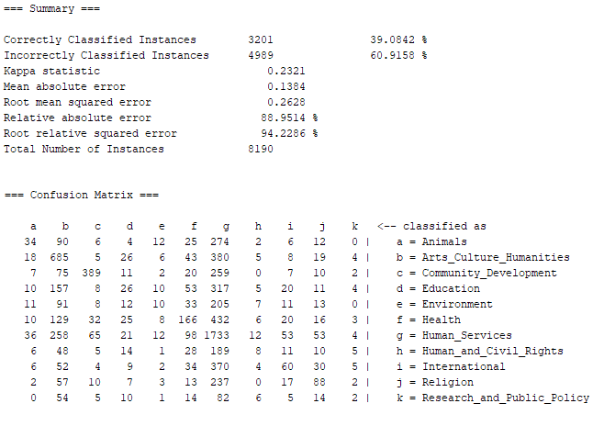
See the Random Forest Through the Decision Trees
4.3x better than random guessing

Slide 14
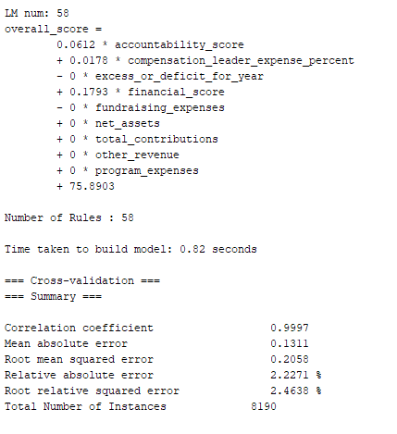
Switching Gears: Classifying by score

Slide 15
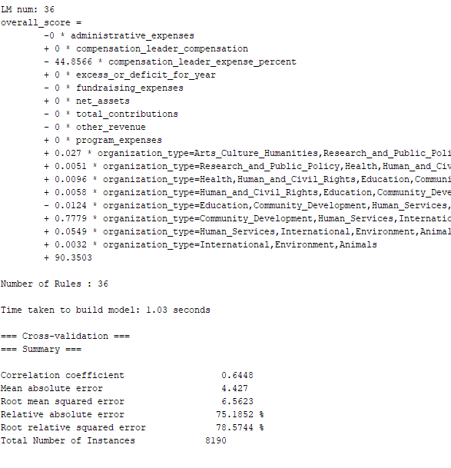
Cut the redundancy

Slide 16
What does it all mean? (Conclusions)
Was the analysis a success?
Overall, not really.
39% predictive for charity type
64% predictive for overall score (“reputation”)
Did I get something out of this?
Yes; the CEO’s paycheck plays a huge role in whether the company is reputable

