Slide 1
Machine Listening with Very Small Training Datasets
Wissam Malke Advisor: Dr. Dale Parson
Master of Computer Science
January 17, 2017

Slide 2
Outline
Introduction:
  Research goals
  Choices we made to reach our goal
  Introduction to Weka?
Body:
  Sonification Research Overview
  Datasets adaptation and characteristics
  Machine learning evaluation process
  Introduction to Machine Learning evaluator tool
  Machine learning models performance
  Introduction to new Sonification algorithms
  Results of processing the new Sonification algorithms by the Survey Listener Tool
  Virtual Survey Listener Tool Benefit
Summary
Questions

Slide 3
Introduction:
Research Goals
Finding machine learning models that are capable of mimicking human learning experience.
Employ the research results to benefit the completion of the Sonification research.

Slide 4
Terms:
Sonification: is aural counterpart to visualization where the difference is visualization maps data attribute values to visual structure, whereas Sonification maps data attribute values to properties of sound.
Parallel Coordinate Plotting: is a data visualization technique for graphing multidimensional relational datasets.
Machine listening is a method for extracting meaningful information from audio signals using machine learning algorithms.

Slide 5
  Choices we made to reach our goal
  Small dataset to train the models
  In order to find machine learning models that mimic human learning, we need to consider the same conditions and datasets that used for human learning.
  In human learning the size of the training dataset is crucial factor.
  It is proven that using small dataset and distributed sessions for training the brain to be the most effective method for learning.

Slide 6
Chose to use the Sonification Datasets
  Sonification training datasets are very small which conform to our main theoretical concept.
  Sonification research results are available and can be compared with the results of our machine learning models.
  Sonification datasets uses separate training and testing datasets to help preventing over-fitting.
  The same datasets will be used for evaluating new Sonification approaches.

Slide 7
Evaluated machine learning algorithms
We evaluated the most commonly used machine learning algorithms
  Bayesian Algorithms: explicitly apply Bayes’ Theorem for problems such as classification and regression
    NaiveBayes
    BayesNet
      Decision Tree Algorithms: use tree model for making decisions.
    RandomTree
    Random Forest
    J48
    REPTree
    Decision Stump

Slide 8
      Ensemble Algorithms: Ensemble machine learning model relies on combining multiple weaker machine learning models.
      AdaBoostM1(Adaptive Boosting)
      Bagging
  Association Rules: extract rules that best explain observed relationships between variables in data.
      OneR
      Instance-based Algorithms: the training data is saved in memory to be used later in the classification process.
      Kstar

Slide 9
Weka Tool
What is Weka?
  Weka is a popular machine learning implementation tool, developed at the University Of Waikato.
  Includes tools for visualization, data analysis, predictive modeling, and transforming datasets.
  Classifiers in Weka take their input in the form of single relational table in the ARFF format.

Slide 10
ARFF format
  Attribute Relation File Format is file format created for standardizing datasets representation.
  Two-dimensional table of data.
  A column gives a single-valued attribute possessed by every instance in the data set, and a row is one instance.

Slide 11
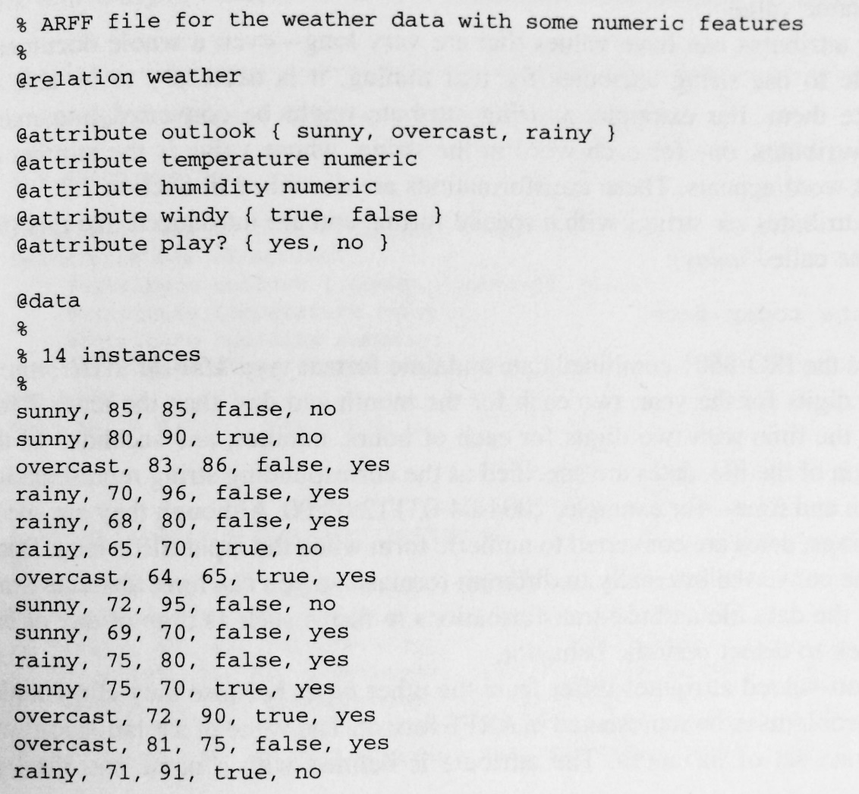
ARFF File Syntax

Slide 12
Body:
Sonification Research Overview
KU researchers used Parallel Coordinate plotting along with some other algorithms for translating datasets from previous studies into sounds.
The similarity between the parallel coordinating plotting and time domain signal audio waveform, made the Sonification process possible.
The following graph shows the results of plotting the dataset records

Slide 13
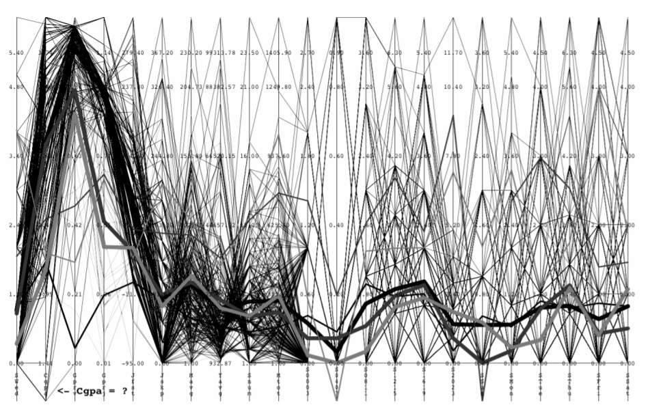

Slide 14
Each thin multi-segment path represents one record in the dataset.
The graph shows three thick paths for the mean of three sets of instances. These paths were determined to be the reference instances.
Sonification generates sounds for each data record in the original dataset and for each of the three reference data instances

Slide 15
The main objective of the research was to find the most effective Sonification approach among three other approaches (harmonic, melodic, and waveform) in terms of generating sounds that are distinguishable by listeners.
The datasets were sonified using the three different approaches.
KU Researchers conducted a survey called Sonic Survey where each listener classifies a data record’s sound as being closest to the reference sound of Set 0, Set 1 or Set 2.

Slide 16
2015 Sonic Survey Result
Sonification (Fall 2015) | Category | Mean correct responses
Harmonic | All 3 sets | 55.8%
Melodic | All 3 sets | 55.4%
Waveform | All 3 sets | 61.4%

Slide 17
Sonification Research Overview
Due to the good results that the waveform algorithm achieved in the 2015 survey.
In the spring of 2016 KU researchers surveyed 3 additional Sonification algorithms that are variations of the waveform algorithm.
However, there are more algorithms that need to evaluated.

Slide 18
2016 Sonic Survey Result
Sonification (Spring 2016) | Category | Mean correct responses
WaveformDouble | All 3 sets | 67.8%
WaveformFourThirds | All 3 sets | 65.8%
WaveformOnePt95 | All 3 sets | 67.6%

Slide 19
    Datasets adaptation and characteristics
Datasets Transformation:
Data transformation step is required to make the data usable in our project
  We use ChucK for transformation step.
  What is ChucK? ChucK is a programming language for real-time sound synthesis and music creation. ChucK presents a unique time-based, concurrent programming model that's precise and expressive.
  A ChucK program is used to analyze the survey WAV files that was produced by the Sonification algorithms, for a second and extracts data sound characteristics.

Slide 20
  Then we pass the transformation output to python data-reformatting scripts for assembling the data and generating ARFF files that are consumable by Weka machine learning classifiers.

Slide 21
Dataset Dissection
  The transformation and formatting steps produce three groups of datasets, each group corresponding to one of Sonification approaches and comprising of 50 datasets.
  A dataset is an ARFF file that comprises 39 instances, each instance is the data that was generated in the transformation process of one WAV file used in the Sonification survey for one participant.
  Instances are split evenly among the three classification reference Sounds in each dataset.
  For each of the three groups there is one training ARFF file that contains the training instances that are generated from the transformation process of the reference sounds WAV files.

Slide 22
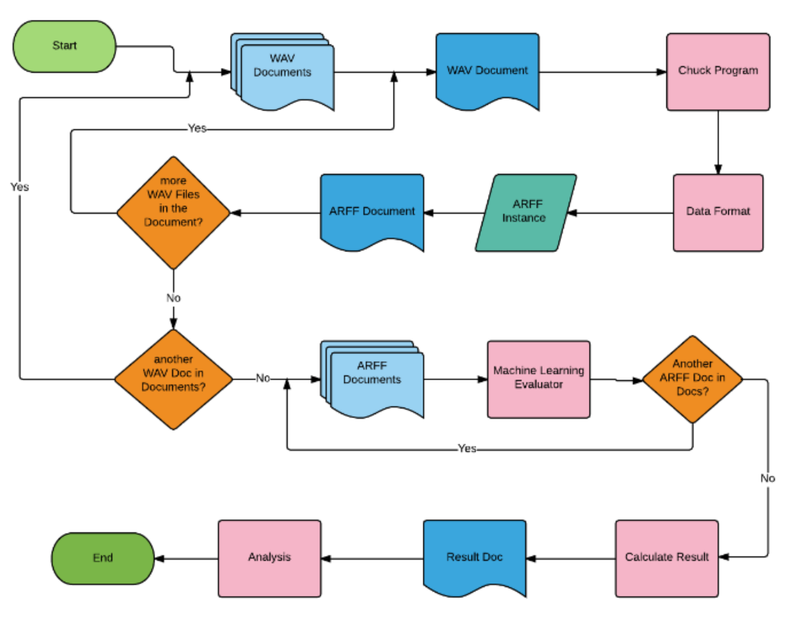
Machine Learning Evaluation Process

Slide 23
In order to assess the performance of a machine learning model:
Train the model using an ARFF training file that corresponds to one of the Sonification approaches.
Input the test data to the machine learning model for classification, where the test data is the set of all ARFF files of that Sonification approach which mean that you have 50 classification process for each of the ARFF files of a Sonification approach.
Calculate the average correct result and standard deviation for the results that were produced by the model using each of the ARFF files, and then calculate the overall average correct results of all averages.

Slide 24
Repeat the previous steps for every Sonification approach.
Repeat the steps for every possible machine learning model and its option variations.

Slide 25
Introduction to Machine Learning Evaluator Tool
Weka Tool Limitation
  Lacks the scalability functionality
  There is a need to do 19,800 run to find the best machine learning model, which is 150 ARFF x 132 machine learning model option variation.
  There is a need to do 118,800 run to find the best Sonification approach among old and new one, which is 900 ARFF x 132 machine learning model option variation.
  Calculate the results as mentioned in the previous section for every machine learning model, then calculate the overall result for all models.
  Impossible without the help of an automated process.

Slide 26
Machine Learning Evaluator Tool :
Due to the lack of Weka tool capabilities, I designed the Machine Learning Evaluator Tool, which is a Java application that extends and scales Weka Tool capabilities.
Machine Learning Evaluator Tool capabilities:
  Navigating through specified directories for loading training and testing datasets.
  Training data models.
  Running test datasets against all possible permutations of classifiers.
  Extracting results for every classifier.

Slide 27
  Calculating the overall result for each classifier for every option variation.
  Filtering classifiers based on their average correct results.
  Saving detailed, summarized, and filtered reports in csv and text files formats.

Slide 28
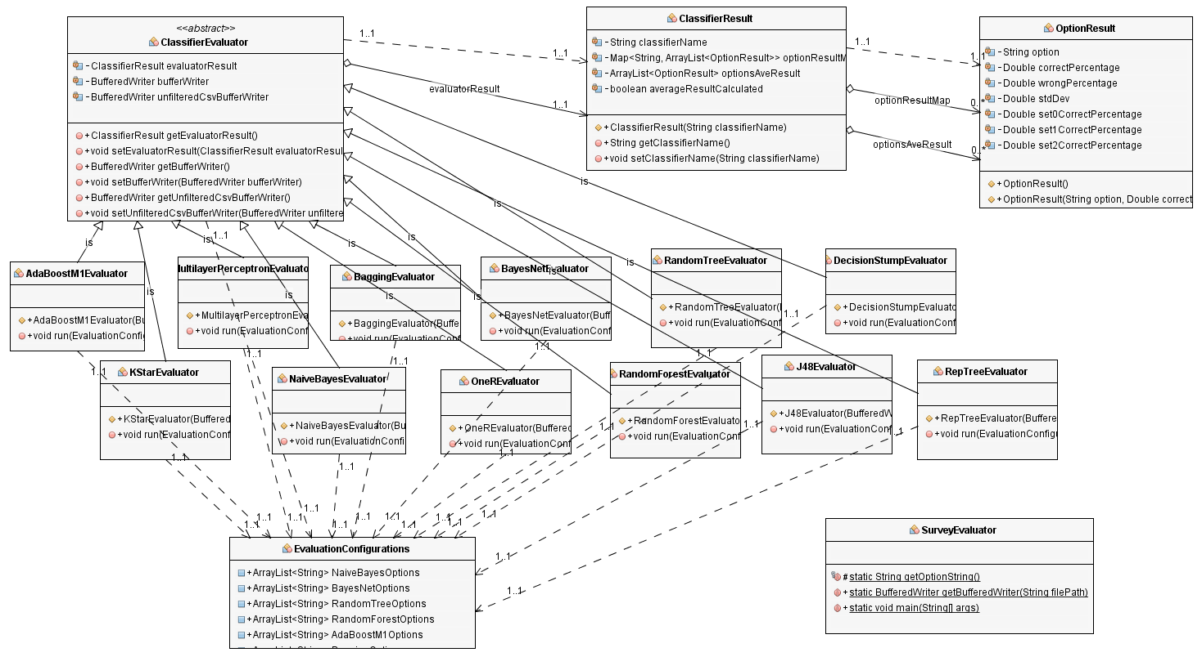
Machine Learning Evaluator Tool Design

Slide 29
  Machine learning models performance on previously surveyed algorithms
After applying the evaluation process on the Sonification approaches that was surveyed previously we get the following results(table is too big cannot be added here):
      Poor Classifiers:
        BayesNet, OneR, J48, REPTree, and ensemble classifiers AdaBoostM1 and Bagging, that use the formerly mentioned classifiers as options produced.
        Very low average correct results’ percentages equal to 33.33%.
        These classifiers usually requires big data sets.

Slide 30
      Classifiers within Human Results’ Range:
        RandomTree Classifier with certain options.
        Average results’ ranges were between 64% and 65%.
        Dominant attributes plays big roll in the model accuracy.
        No tree pruning.

Slide 31
      Classifiers Which Exceeded Human Results’ Range:
        Kstar, and the ensemble classifiers such as AdaBoostM1 and Bagging classifier that used HoeffdingTree for boosting the performance performed very well.
        Results were in the range of 68% – 78% average correct classifications’ percentages.
        Kstar predicts the class of an instance is based upon the class of those training instances similar to it.
        HoeffdingTree classifier exploits the fact that a small sample can often be enough to choose an optimal splitting attribute.

Slide 32
Virtual Survey Listener Tool
  Using previous results, we will be using the RandomTree classifier with the options that produced the closest results to human results for evaluating new Sonification approaches.
  Using the RandomTree Classifier in conjunction with the Machine Learning Evaluator Tool will produce the Virtual Survey Listener.

Slide 33
  Introduction to new Sonification algorithms
Two sets of algorithms.
First set uses saw tooth wave form:
  Waveformdblsaw uses 2 times the frequency of the original waveform frequency.
  Waveform43rdssaw uses 4/3 times the frequency of the original waveform frequency.
  Waveform195saw uses 1.95 times the frequency of the original waveform frequency.

Slide 34
Second set uses reverse saw tooth wave form:
  Waveformdblrevs uses 2 times the frequency of the original waveform frequency.
  Waveform43rdsrevs uses 4/3 times the frequency of the original waveform frequency.
  Waveform195revs uses 1.95 times the frequency of the original waveform frequency.

Slide 35
Results of processing the new Sonification algorithms by the Survey Listener Tool
After inputting all Sonification algorithms old and new to the Virtual Survey Listener tool we get the following
Sawtooth waveform algorithms performed better than the algorithms that use the other types of waveforms.
The best Sonification approach overall is Waveformdblsaw, where the Virtual Survey Listener tool was capable of achieving 76.05% average correct classification.

Slide 36
Virtual Survey Listener Tool Benefit
Evaluating Sonification approaches become very easy.
Time and cost effective.
Generic tool for evaluating any dataset.

Slide 37
Questions?

