Slide 1
Dissolved Oxygen and pH in streams: Shale and Limestone Bedrock
CSC 558 Final project - Nathan Wilson Rew

Slide 2
Data Set

Slide 3
Data Set Attributes
Gage height
Discharge
Temperature
Specific conductance
Minute of year
Minute of day
Day of year
Shale/Limestone
pH
Dissolved oxygen

Slide 4
Data Set Acquisition
USGS stream sampling data
Which sites are in streams that flow over limestone?
Which sites are in streams that flow over acidic rock (shale)?
Get latitude and longitude

Slide 9
Data Cleaning
Extract data from raw text using re in Python
Switch attribute ID numbers for attribute names
Store as JSON for remaining steps
Extract time attributes from raw data timestamps
Merge the data from both sites
Convert to Weka's JSON format
Normalize data inside Weka
Export to .arff

Slide 10
Analysis

Slide 11
Dissolved oxygen
Two quick tests
All attributes
Bedrock type only
In both cases, coefficient was negligibly small (<0.1)

Slide 12
pH
Several tries before zeroing in on a simple but accurate model
Discoveries
Discharge and gage height have high influence
Specific conductance may be redundant with pH
Temp. C is less influential than minute of year
Negative correlation between bedrock type and pH

Slide 13
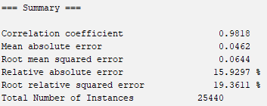
pH

Slide 14
pH
Why a negative correlation?
Surface conditions?
Pollution?
Counterintuitive, needs more research to say anything conclusive

