Slide 1
SIMULATED CONTACT TRACING OF COVID-19 PROPAGATION AT KUTZTOWN UNIVERSITY FOR FALL 2020
Dale E. Parson, https://faculty.kutztown.edu/parson, April 10, 2021
Department of Computer Science & Information Technology
Kutztown University of PA
2021 Conference of PA Computer & Information Science Educators

Slide 2
Background for a summer 2020 simulation study
In May 2020 the administration was aggressively advocating for face-to-face classes in the fall.
March 2020 plans for return from spring break had been aggressive.
Some faculty requests for remote classes granted only 2 weeks before start of fall classes.
No STEM faculty and initially no faculty on the planning team.
Queried class-section rosters with faculty & student IDs.
Simulate the spread of COVID@KU using documented parameters in an attempt to inform decision makers.
Simulations from Cornell & UCLA did not use roster-based tracing.

Slide 3
No simulated contact tracing infection rate spread with R₀=1.25 and 6 initial infections
WEEK | NEW | TOTAL
1 | 8 | 8
2 | 9 | 17
3 | 12 | 29
4 | 15 | 44
5 | 18 | 62
6 | 23 | 85
7 | 29 | 114
8 | 36 | 150
9 | 45 | 195
10 | 56 | 251
11 | 70 | 321
12 | 87 | 408
13 | 109 | 517
14 | 136 | 653
15 | 171 | 824

Slide 4
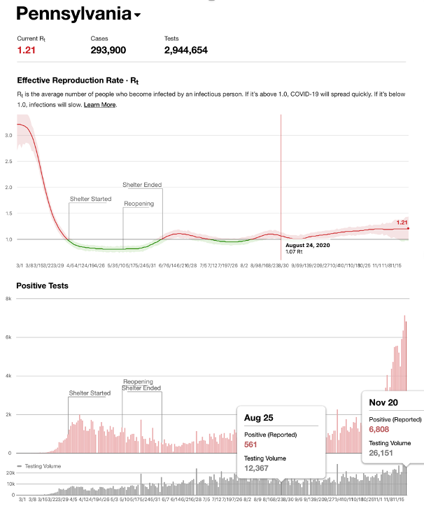
R_{t} testing-based estimates of R₀ for 2020 from https://rt.live

Slide 5
Time frames for simulations
Python-encoded non-graphical simulation based on spreading activation across course roster graph completed and summarized in a white paper May 28, revised per feedback on details by biologist professors by June 2.
Distributed to faculty and author’s chain of command, some positive feedback from biology professors and the provost.
Graphical simulation in Java/Processing framework adapted and posted to YouTube on July 16.
Distributed at KU & publicly, 804 views during first 2.5 weeks, 990 as of April 7, 2021.

Slide 6
The Graphical Demo
https://youtu.be/f2Tto1BTErs
Interactive demo of the
graphical simulation at PACISE

Slide 7
Screen Shot with Primary Parameters

Slide 8
Inter-Class Connectivity Histogram

Slide 9
The Primary Graph Classes
Notes:
The class named Class houses data about a course offering typical of roster databases. The Attendee class houses data about a faculty member or student. There is one Class object for each course offering with some face-to-face attendance as of May 16, and one Attendee object for each attending faculty member or student as of May 16. An Edge object connects two Classes with its one-or-more Attendees in common.
EdgeStudents is a related class that records number of student Attendees attending a pair of Class objects connected by an Edge, along with the number of infected students having those two Classes.

Slide 10
Simulation driver functions slide 1 of 2
loadData(classesCSV : String, studentsCSV : String, coursenumMap : String)
initSimulationState(R0 : float, seed : integer) : Attendee []
advanceState() {
CONDITIONALLY (at start of semester)
initSimulationState(R0, null);
simState(currentWeek, people); // update simulation state
advanceStatsPerWeek(currentWeek); // update statistics database
}
Notes:
The class named Class houses data about a course offering typical of roster databases. The Attendee class houses data about a faculty member or student. There is one Class object for each course offering with some face-to-face attendance as of May 16, and one Attendee object for each attending faculty member or student as of May 16. An Edge object connects two Classes with its one-or-more Attendees in common.
EdgeStudents is a related class that records number of student Attendees attending a pair of Class objects connected by an Edge, along with the number of infected students having those two Classes.

Slide 11
Simulation driver functions slide 2 of 2
simState(week : integer, peopleList : Attendee []) {
for (Attendee p : peopleList) {
p.checkRecovery(week);
p.spreadInfection(week) ; // spreading activation
}
}
An analysis from Santa Fe Institute: “R₀ is just an average: the transmission rate varies widely, and outbreaks can be surprisingly large even when the epidemic is subcritical.”
Notes:
The class named Class houses data about a course offering typical of roster databases. The Attendee class houses data about a faculty member or student. There is one Class object for each course offering with some face-to-face attendance as of May 16, and one Attendee object for each attending faculty member or student as of May 16. An Edge object connects two Classes with its one-or-more Attendees in common.
EdgeStudents is a related class that records number of student Attendees attending a pair of Class objects connected by an Edge, along with the number of infected students having those two Classes.

Slide 12
University response to the simulations
Useful feedback from several biology professors
Better estimates & application of R0.
Estimate of courses disrupted for infected professors too low.
Provost read the white paper & viewed the video
Read entire white paper, interested in simulated contact tracing.
Pointed to student code of contact after viewing narrated video.
Invited & then disinvited to review the university plan
They may have used paper’s advice on per-faculty lavalier mics.
Reworked classroom distance plans after a failed audit.
Decision to accommodate faculty on-line requests 2 weeks before classes.
Notes:
The class named Class houses data about a course offering typical of roster databases. The Attendee class houses data about a faculty member or student. There is one Class object for each course offering with some face-to-face attendance as of May 16, and one Attendee object for each attending faculty member or student as of May 16. An Edge object connects two Classes with its one-or-more Attendees in common.
EdgeStudents is a related class that records number of student Attendees attending a pair of Class objects connected by an Edge, along with the number of infected students having those two Classes.

Slide 13
Somebody Else's Problem Field Hitchhiker’s Guide to the Galaxy
An S.E.P. can run almost indefinitely on a torch or a 9 volt battery, and is able to do so because it utilizes a person's natural tendency to ignore things they don't easily accept, like, for example, aliens at a cricket match. Any object around which an S.E.P. is applied will cease to be noticed, because any problems one may have understanding it (and therefore accepting its existence) become Somebody Else's Problem. An object becomes not so much invisible as unnoticed.
https://hitchhikers.fandom.com/wiki/Somebody_Else%27s_Problem_Field
Notes:
The class named Class houses data about a course offering typical of roster databases. The Attendee class houses data about a faculty member or student. There is one Class object for each course offering with some face-to-face attendance as of May 16, and one Attendee object for each attending faculty member or student as of May 16. An Edge object connects two Classes with its one-or-more Attendees in common.
EdgeStudents is a related class that records number of student Attendees attending a pair of Class objects connected by an Edge, along with the number of infected students having those two Classes.

Slide 14
University daily report for December 22
Positive cases | Today 12/22 | This week 12/21-25 | Total cases since 8/24 | Active cases | Recovered cases
Students living on campus | 0 | 0 | 158 | 1 | 407
Students living off campus | 1 | 1 | 250
Employees | 5 | 5 | 19 | 4 | 15
Total | 6 | 6 | 427 | 5 | 422
Notes:
The class named Class houses data about a course offering typical of roster databases. The Attendee class houses data about a faculty member or student. There is one Class object for each course offering with some face-to-face attendance as of May 16, and one Attendee object for each attending faculty member or student as of May 16. An Edge object connects two Classes with its one-or-more Attendees in common.
EdgeStudents is a related class that records number of student Attendees attending a pair of Class objects connected by an Edge, along with the number of infected students having those two Classes.

Slide 15
University daily report for April 7 – Fall partiers likely have temporary immunity
Positive Cases | Today (4/7) | This Week (4/5-9) | Total Cases (since 1/19) | Active Cases | Recovered Cases
Students Living On-Campus | 0 | 1 | 27 | 6 Combined | 71 Combined
Students Living Off-Campus | 2 | 2 | 50
Employees | 0 | 1 | 25 | 3 | 22
Total | 2 | 4 | 102 | 9 | 93
Notes:
The class named Class houses data about a course offering typical of roster databases. The Attendee class houses data about a faculty member or student. There is one Class object for each course offering with some face-to-face attendance as of May 16, and one Attendee object for each attending faculty member or student as of May 16. An Edge object connects two Classes with its one-or-more Attendees in common.
EdgeStudents is a related class that records number of student Attendees attending a pair of Class objects connected by an Edge, along with the number of infected students having those two Classes.

Slide 16
Reported and Projected Infections for Fall 2020

Slide 17
Reported and Projected Percentages of Students for Fall 2020

Slide 18
February 8, 2021 Simulation of Fall 2020

Slide 19
The Rocket (SLU student publication): PASSHE COVID-19 cases surpass 900 as semester nears its end, State system cases total less than half of previous semester's

Slide 20
The Rocket: PASSHE COVID-19 cases surpass 900 as semester nears its end, State system cases total less than half of previous semester's
Based on the case numbers visible on its dashboard, Kutztown University has the highest accumulated case numbers in the state system with 542 student and faculty cases. The PASSHE school also differentiates between on- and off-campus cases, with 188 on-campus positive student cases and 300 off-campus. The remaining 54 are reported employee cases.
http://www.theonlinerocket.com/news/2021/04/05/passhe-covid-19-cases-surpass-900-as-semester-nears-its-end/?fbclid=IwAR0D-mSxUEYsW29uVjyxXzF78ZpHI0rfyk9MlHChAC3HMRDhkQZTwSN8-uc
April 5, 2021

Slide 21
Looking to the future
Increased availability of vaccines but not 100% acceptance.
Current vaccines will be somewhat over-fit to initial strains.
People are letting their guard down.
~20% of attendees at Kutztown Farmer Market maskless.
University planning indoor face-to-face commencement.
University planning return to “pre-pandemic” classes in the fall.
Look out for your own, your family’s, and your neighbors’ well being.
Apply pressure as needed.

