Slide 1
PREPARING AND TEACHING DATA SCIENCE COURSES
Four Case Studies in Stages of Preparation
PACISE 2024 @ Kutztown University
Dale E. Parson

Slide 2
Prepping & Teaching Data Science: Outline
1. There must be a human domain expert.
2. Analysts must locate and obtain datasets.
3. Someone writes data cleaning and structuring scripts.
4. Analysis is iterative because of deepening discoveries.

Slide 3
1a. Expertise in teaching Java programming
The expert can be and often is the instructor.
Spring 2013 and spring 2014 Java programming students.
Intent is to correlate work habits to project grades.
Colleagues anticipate procrastination is a major factor.
Grad students in first KU data science course make suggestions.
Project makefiles collect the data.
Instructor is conversant with makefile technology.
There is some literature related to the analysis topic.

Slide 4
1b. Expertise in PA stream flow analysis
Instructor & son were volunteer samplers for Maidencreek Watershed Association for two years around 2005.
Dissolved oxygen, pH, water temperature, etc. in monthly samples.
We sampled the Willow Creek at Maiers Grove in Blandon, PA.
US Geological Survey has large datasets on-line for free.
Physical & chemical properties via sensors every 15 minutes.
Instructor’s nephew with a Ph.D. in environmental engineering served as a free consultant.
Published research results are available for confirming or refuting student analysis results.

Slide 5
1c. Expertise in audio signal analysis
Instructor architected & coded software tools for digital signal processor application programmers in Bell Labs / Agere from 1994-2002.
Instructor coded & performed digital music generators, filters, and analyzers starting in 2005, assisted by experts on https://electro-music.com/ forum started by former Bell Labs DSP colleague.
International concerts with streaming audio & chat was the genesis of CS&IT’s Real-time Virtual Classroom (RTVC) piloted in 2014.
Instructor & musician students began multimedia performances with invited guests in KU Planetarium in 2011.
Instructor has been teaching multimedia programming that includes an audio generation project since fall 2015.
Instructor has published research in aural architecture & acoustics.
My favorite from summer 2018 with 6 1000—watt speakers in the planetarium.

Slide 6
1da. Expertise in raptor migration & related
Dr. Laurie Goodrich, Sarkis Acopian Director of Conservation Science, Hawk Mountain Sanctuary in northern Berks County.
Volunteers have been collecting weather data & raptor counts since 1934, mostly on an hourly basis after the initial years.
We began working together for CSC458 Predictive Analytics I in 2019.
The focus is on correlating climate change and other changes to changes in raptor counts.
Instructor was a member of the Sanctuary for years and is conversant with the environment & climate of the Hawk Mountain area.
Instructor’s background includes training at the Nolde Forest Environmental Center.

Slide 7
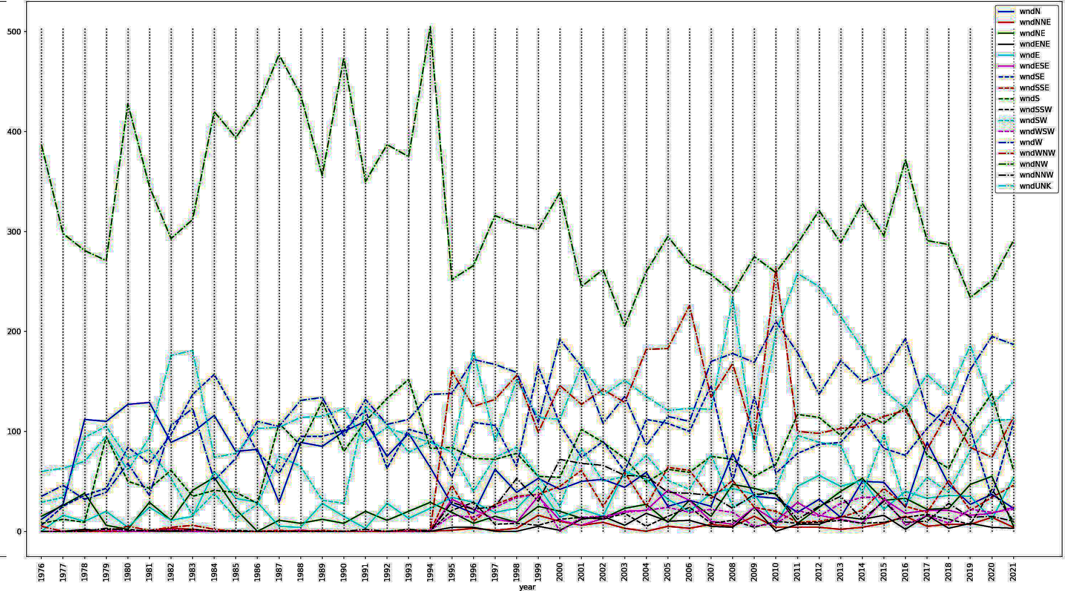
1db. Example where a domain expert is essential: Changes in data encodings

Slide 8
2/3a. Data in teaching Java programming (1)
Students type make build and make test for compile & test.
Institutional Review Board (IRB) approval for human subject data.
KU Assessment grant supported summer stipend & student workers.
Instructor wrote 3525 non-blank lines of Python code in 13 scripts and libraries to integrate data from automated makefile collection of student build / test / submit actions, surveys, grade information, and other course roster data into a CSV file for analysis of the spring 2013 dataset. Numbers jumped to 4247 non-blank Python lines in 14 scripts and libraries because of an extension to perform new within-students analysis in 2014. Taught a session at a CS Education Conference in Vegas.
Student worker wrote Excel scripts using her own data to confirm correctness of the Python data cleaning & structuring scripts.

Slide 9
2/3a. Data in teaching Java programming (2)
107 attributes reported in PACISE 2015 refereed paper
11 started-until-due-hours Jstr (round to nearest hour)
12 Jstr - hours lost to skipped days Jfst (Jstr - 24 * each skip)
17 mean-session-time-minutes Mavg
61 number-sessions-centered-hour0-3 S0003
62 number-sessions-centered-hour4-7 S0407
84 grade point average in csc >= 125 Cumm
94 spread-grade-for-student-course GprjSpr (added 9/17/2014)
95 my-grade-for-student-course GprjMy (added 9/17/2014)

Slide 10
2/3b. Data prep in stream flow analysis (1)
timestamp measured
pH measured
TempCelsius measured
Conductance measured
GageHt measured
DischargeRate measured
TimeOfYear derived attribute
Month derived attribute
MinuteOfDay derived attribute
MinuteOfYear derived attribute
OxygenMgPerLiter measured
Based on project goals and data availability
46 automated sampling sites with over 490,000 stream sample records

Slide 11
2/3b. Data prep in stream flow analysis (2)
Data from USGS site still is not to be available as CSV file.
This requires parsing via a Python script with regular expressions.
504 non-blank lines of Python code in 2 scripts.
Sample records verification made via hand calculator.
# USGS 01451500 Little Lehigh Creek near Allentown, PA
# Data provided for site 014670261
# TS parameter Description
# 121337 00010 Temperature, water, degrees Celsius
# 121338 00300 Dissolved oxygen, water, unfiltered, milligrams per liter
# Data-value qualification codes included in this output:
# P Provisional data subject to revision.
agency_cd site_no datetime tz_cd 121337_00010 121337_00010_cd 121338_00300 121338_00300_cd
5s 15s 20d 6s 14n 10s 14n 10s
USGS 014670261 2024-02-07 00:00 EST 4.7 P 12.4 P
USGS 014670261 2024-02-07 00:15 EST 4.7 P 12.4 P
USGS 014670261 2024-02-07 00:30 EST 4.7 P 12.4 P

Slide 12
2/3b. Data prep in stream flow analysis (3)
Analysis in a later project crowd sourced training site data collection and analysis to find representative training data sites.
Course students served as the crowd searching in parallel.
A student helped uncover a previously missed data relationship.
Web scraping software would be ideal if project were ongoing.

Slide 13
2/3c. Data prep in audio signal analysis
Data generated as statistical distributions of 5 waveform types.
Sine, triangle, square, sawtooth, and pulse waveforms.
Early generation used 10,005 ChucK scripts generated by a Python script.
Early extraction of frequency data from time-domain waves via ChucK.
Current extraction is via the SciPy wave library and fft library function.
Analysis fed back into data structuring for waveform classification projects.
Current projects use derived structures for numeric attribute regression.
Tagged target properties include signal type, signal gain, white noise gain, and a unique record identifier.
Data extraction / structuring schemes take ~300 lines of Python.
Instructor uses them in class to teach Python to scripting newcomers.

Slide 14
2/3d. Data prep Hawk Mountain counts (1)
Trained, experienced volunteers collect data deployed as Excel.
There are an assortment of data entry errors on North Lookout.
Missing data recorded as sequences of zeroes.
Accidental duplicate typing of numbers cleaned via standard deviation.
Sum of raptor species sub-counts not always equal to _all count.
My script takes the larger.
Three-letter wind direction, e.g., WNW, recorded as WWN, etc. Started 1995.
Treetop versus wind gauge wind speed measurement change.
Weather data was not captured consistently before 1976.
NOAA Allentown Airport weather data does not correlate well.
4168 lines of non-blank Python in 4 scripts.
Aggregation into per-day, per-week, per-month, and per-year statistics.
Validation again via hand calculator with typical & outlier records examined.

Slide 15
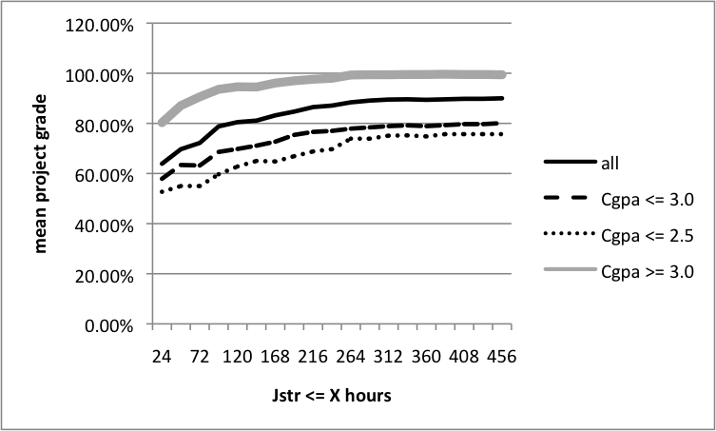
4a. Some results analyzing Java students (1)
Start time before deadline -> project grade correlations (14 days == 336 hours).

Slide 16
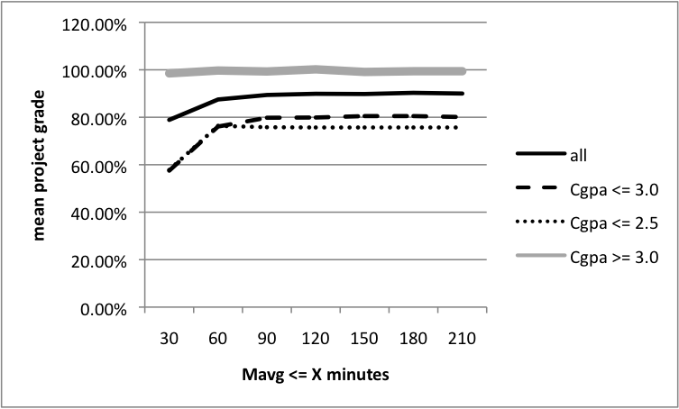
4a. Some results analyzing Java students (2)
Work session time -> project grade correlations (50 to 60 mins. required).
Working too many 11 AM to 7 AM shifts correlated negatively.

Slide 17
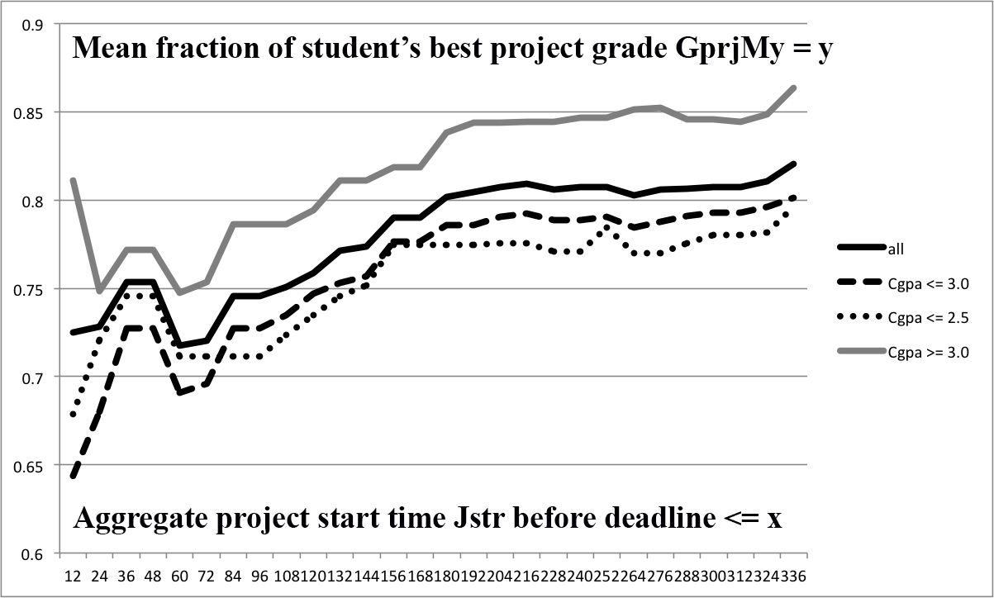
4a. Within students with 20-point spread (3)
Start time before deadline -> project grade correlations (14 days == 336 hours).

Slide 18
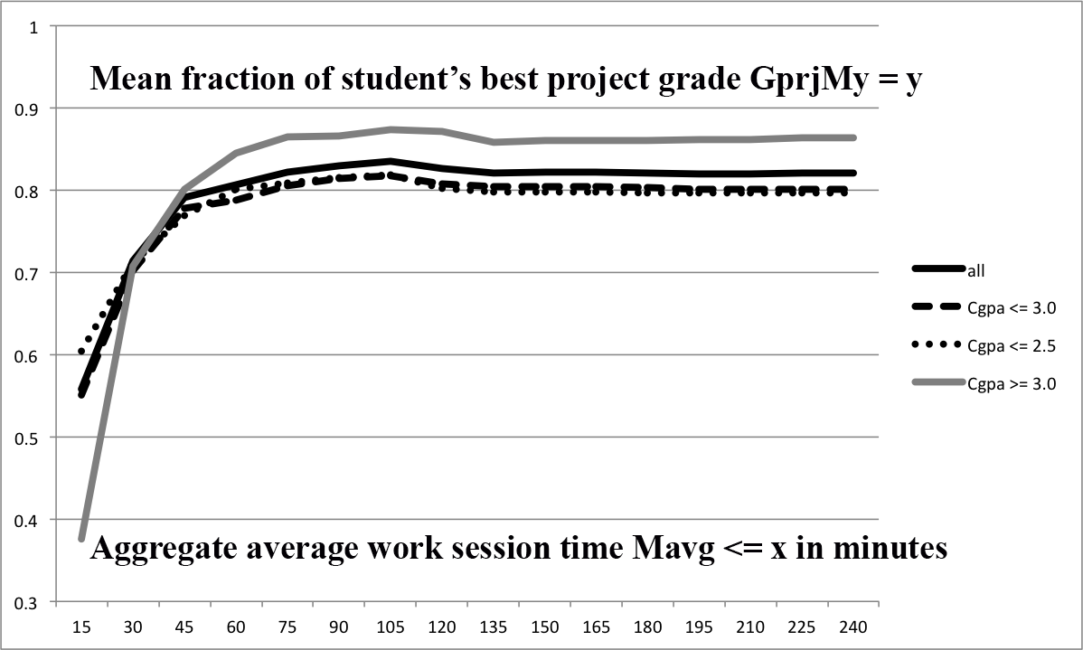
4a. Within students with 20-point spread (4)
Work session time -> project grade correlations (50 to 60 mins. required).

Slide 19
4b. Dissolved oxygen from day of year (1)

Slide 20
4b. Dissolved oxygen from hour of day (2)

Slide 21
4c. Frequency histogram of square wave (1) Iterative exploration found normalization of harmonics to amplitude & frequency of fundamental ideal for classification

Slide 22
4d. Grant-funded Summer 2022 and summer 2023 analyses of Hawk Mountain wind speed, direction -> counts is ongoing (1)

Slide 23
4d. Fall 2019 CSC 458 Predictive Analytics I visit (2)

Slide 24
Conclusions
Expertise and existing research sources for verification of analyses is essential. Scripts need independent verification of lack of bugs.
Reliable data that likely needs some cleaning is central.
Iterative analysis is always necessary.
I compare it to archeology. Repeated shoveling finds new information.
Reporting via classroom presentations, papers, & conference presentations is essential.
Acknowledgements to Dr. Laurie Goodrich for her time & data, and Dr. Lisa Frye for supporting my curriculum explorations.

