Slide 1
Data Collection, Cleaning, and Analysis of Gamers at Kutztown and their habits
Connor Ellis

Slide 2

Data Collection
1
The first step of data collection is deciding what data you want to collect.
I decided that I should study gamers because it was likely that I would get a large response.

Slide 3

Designing Fair Questions
Questions need to be…
Clear
Concise
1-time parsable
Unbiased
Biased Question
“What do you hate most about KU’s COVID-19 policies?”
Unbiased Question
“What are your thoughts about KU’s COVID-19 policies?”
Biased Questions are more likely to illicit a response that the surveyor is looking for and not what the person really means.

Slide 4


Deploying the Survey
Discord ~ 70 responses
Email ~ 35 responses

Slide 5
Attributes
Class: A students year, freshman, sophomore …etc
Major: string, A students’ major(s)
Minor: string, A students’ minor(s)
Current GPA: A students’ current GPA
Gender: A students’ gender
Semesters Completed at KU: The # of semesters a the student has completed at KU
What kind of games do you play: A scale of 1 to 5 describing if the student plays more casual games of more competitive games
How do you play those games: A scale of 1 to 5 describing if the student plays games in a more casual manner or a more competitive manner
Sleep on School Night: The average time a student gets to sleep on a night that they have class the next day
Sleep on Non-School Night: The average time a student gets to sleep on a night that they have do not have class the next day
10 different game categories, each with a scale of 1 to 10. 1 being I don’t like this game genre, 10 being I do like this game genre. Below are the genres
Sandbox, Real-Time Strategy, Shooters, Multiplayer Online Battle Arena, Role-Playing, Simulation & Sports, Puzzle and Party, Action-Adventure, Survival & Horror, Platformer
Setup: If the student own their own gaming console/computer
Money Spent on Setup: How much money the student spent on their gaming setup
Money Percentage: How much of their own money was used to purchase their gaming setup
Hours Gaming Alone Daily: On average, every day, how many hours are spent gaming alone
Hours Gaming with Friends Daily: On average, every day, how many hours are spent gaming with friends
Non-Gaming Hours Spent with Friends Daily: On average, every day, how many hours are with friends while not gaming
Hours doing Homework Daily: How many hours the student spends on homework every day
Weekly Days Exercising: How many days out of the week the student exercises
Weekly Days Partying: How many days out of the week the student parties
Job: Does the student have a job
Weekly Work Hours: How many hours a week does the student work

Slide 6
Cleaning
2
RemoveUseless removed two attributes that
regarded consent in the study. Both had only one
answer possible and would not be valuable to
this research.
Used MergeManyValues to take many string values and merge them into one.
Major and Minor was all string data
Major cleaned from 44 unique responses to 18
Minor cleaned from 26 unique responses to 13

Slide 7
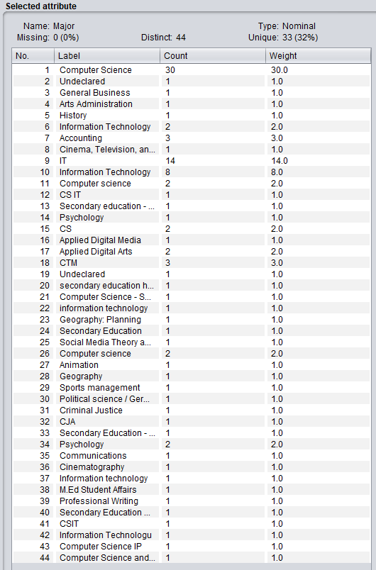

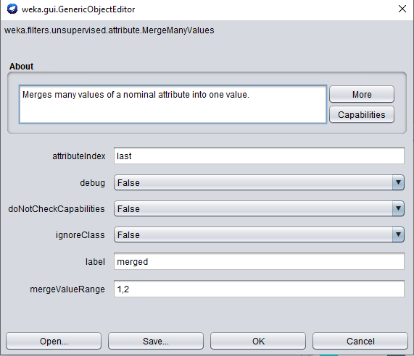
Cleaning String Inputs
MergeManyValues

Slide 8
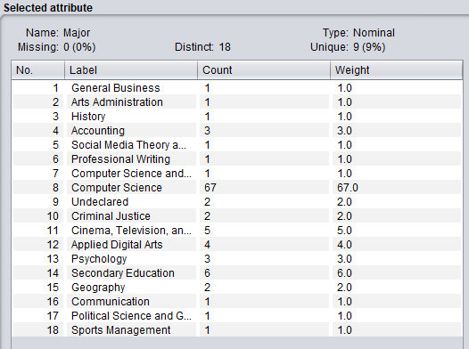

Cleaning String Inputs
MergeManyValues

Slide 9
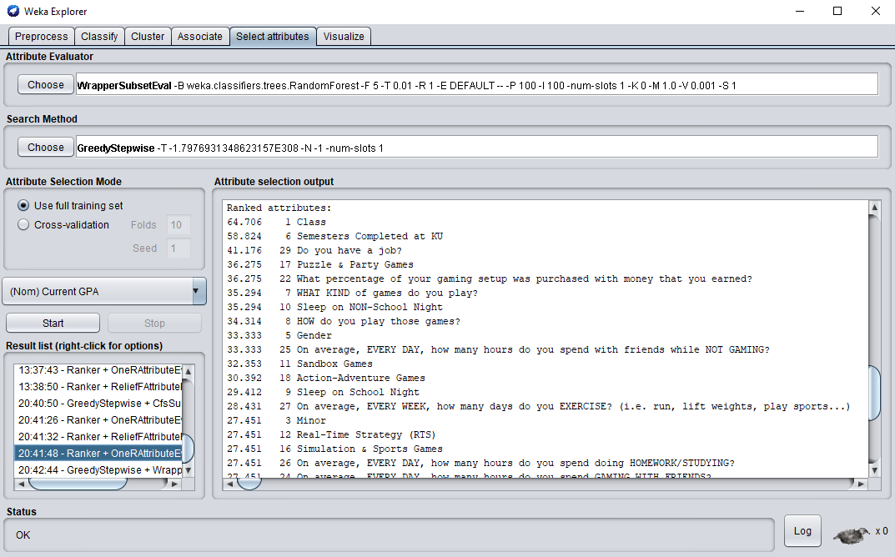
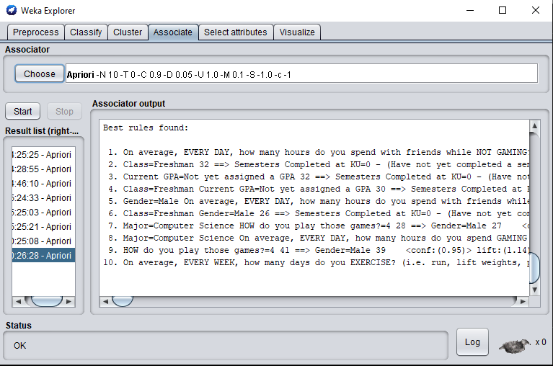
Analysis
3
Select Attributes
Associate

Slide 10
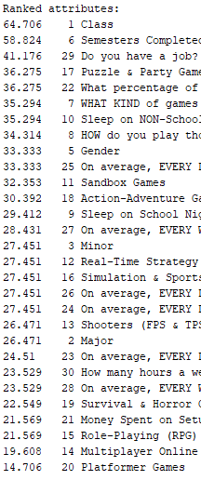
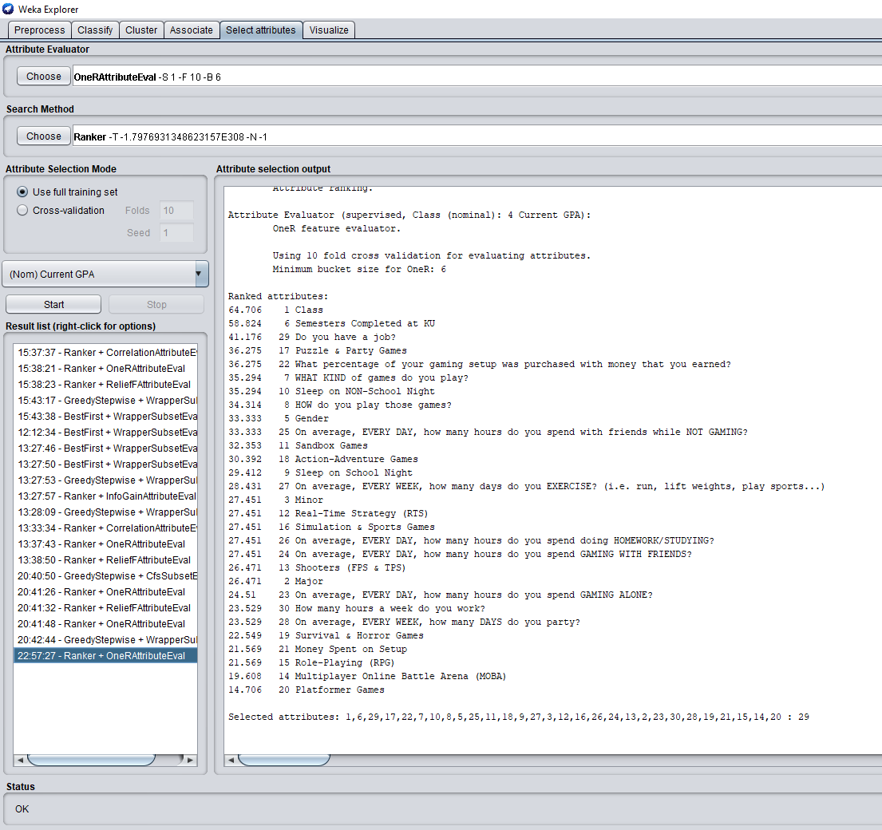
Select Attributes
Uses Attribute Evaluators paired with a Search Method
Determines how valuable other attributes are to a target attribute
Assigns a value to each non-target attribute. This value will change dependent on what Eval and Search Method you use.

Slide 11
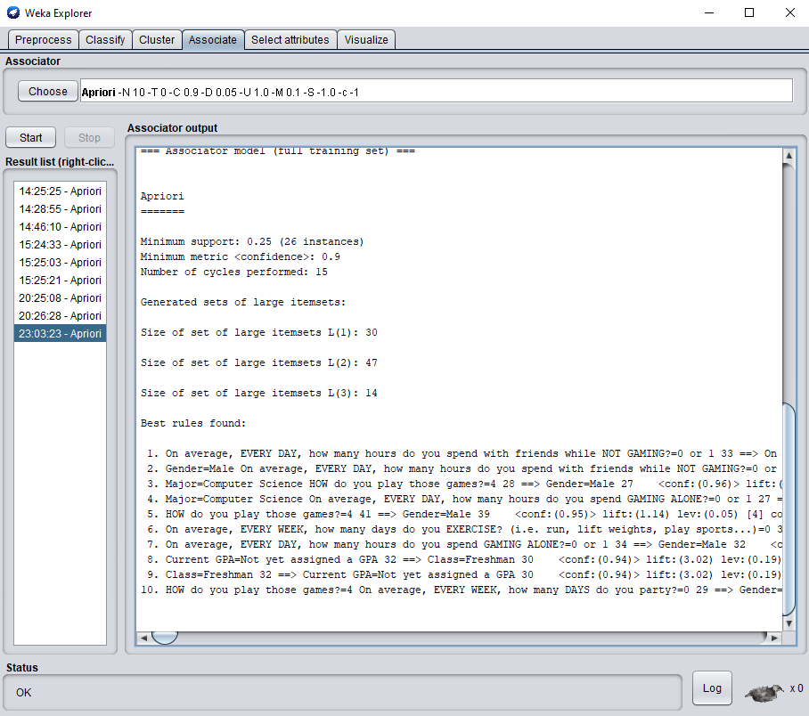
Associate
Uses Associator algorithms to determine data rules.
A rule is a statement about how ownership of some attribute also means ownership of another.
Sleep on NON-School Night=1:00:00 AM Action-Adventure Games=10 11 ==> Do you have a job?=Yes 10 <conf:(0.91)> lift:(1.91) lev:(0.05) [4] conv:(2.88)
Current GPA=3.50 - 4.00 20 ==> On average, EVERY WEEK, how many DAYS do you party?=0 20 <conf:(1)> lift:(1.3) lev:(0.05) [4] conv:(4.66)
Simulation & Sports Games=1 20 ==> On average, EVERY WEEK, how many DAYS do you party?=0 20 <conf:(1)> lift:(1.3) lev:(0.05) [4] conv:(4.66)
How do you play those games?=4 41 ==> Gender=Male 39 <conf:(0.95)> lift:(1.14) lev:(0.05) [4] conv:(2.26)
How many hours do you spend with friends while NOT GAMING?=0 or 1 33 ==> On average, EVERY WEEK, how many DAYS do you party?=0 33 <conf:(1)> lift:(1.3) lev:(0.07) [7] conv:(7.69)

Slide 12
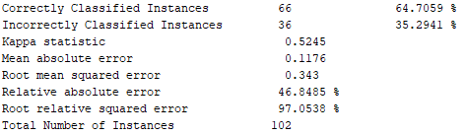
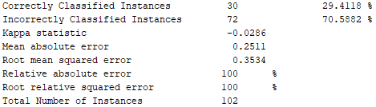
Classification
Most accurate classifier was OneR. While its classification rule is simple, it found that Class was the most efficient way of guessing GPA. The rule it chose was to map Class to GPA in this fashion…
Graduate Student -> 3.50 - 4.00
Senior -> 3.00 - 3.49
Junior -> 2.50 - 2.99
Sophomore -> 3.00 - 3.49
Freshman -> Not yet assigned a GPA
My least accurate classifier was ZeroR. This is for the obvious reason that ZeroR ignores all predictor attributes and only guesses the majority category. This also was the only negative Kappa that I saw during this research.

Slide 13
Thank You!
Are there any questions?

