Slide 1
Assessing a Scholarship Program for Underrepresented Students in Computer Science & Information Technology
Patrick Earl, Lisa Frye, & Dale Parson
Proceedings of the 35th Annual Spring Conference of the Pennsylvania Computer and Information Science Educators
West Chester University of PA, West Chester, PA, April 3-4, 2020

Slide 2
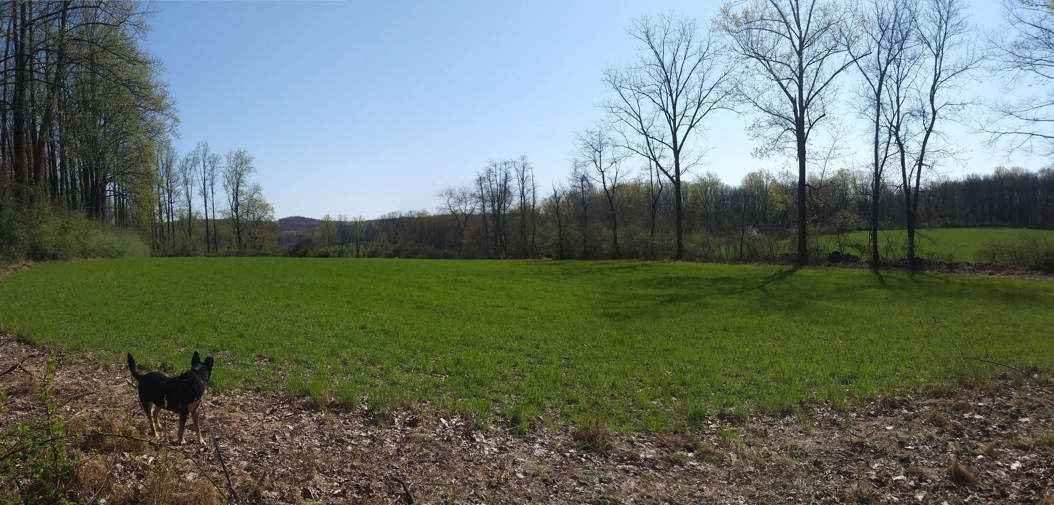
Social Distancing and the Arrival of Spring

Slide 3
The Original Proposal and Faculty
Proposal to increase representation of women and ethnic minorities in our major and STEM majors via scholarships & support.
Dr. Lisa Frye (PI), Professor Linda Day, Dr. Randy Kaplan 2013 & 2014
  Both proposals rejected by NSF with suggestions for revisions.
Dr. Randy Kaplan (PI), Dr. Lisa Frye, Professor Linda Day 2015
  Proposal received funding of $614,375 for 5 years in March 2015
  Scholarships, textbooks, tutors, supplemental instructors, mentors, graduate data collector / analyst, conference travel & travel to present, activities.

Slide 4
The Original Assessment Goals
Track students recruited into the program, retention in computer science or other STEM discipline, graduation rate in computer science or other STEM discipline, and their employment (or grad school) in a computer science or other STEM field. The project target is to increase graduation rates to 80% over the course of the project.
Learning outcomes for the project...assessments routinely conducted by the computer science project will be utilized...and spatial ability.
Assessment of the culture experienced by students will include both process and product, and one measure will utilize the journal portion of the project. The journals will be reviewed to determine the quality of the experiences...

Slide 5
The Reorganized Faculty, Staff
Dr. Randy Kaplan (PI), Dr. Lisa Frye, Dr. Dale Parson, March 2015
  Professor Day retired very shortly after NSF funding in March 2015.
  Dr. Kaplan went on sick leave 2016-2017, retired at start of spring 2018.
Dr. Lisa Frye (PI), Dr. Dale Parson, Spring 2018 through present.
Grad students Prateeksha Patel (Counseling 2015-2018), Patrick Earl (CSC 2018-2019), data collection & analysis
Selection Committee: Drs. Frye & Parson, Dr. Anne Zayaitz (Provost), Ms. Holly Fox (KUIT), Professor Linda Day (retired)
Support from Mr. Jeff Werner (Assistant Provost, Grants & Sponsored Projects)

Slide 6
Most Recent U.S. Enrollment Demographics
2018 annual Computer Research Association's Taulbee Survey
  Removed computer engineering & consolidated small groups
80.5% male and 19.5% female
White | Black | Hispanic | Asian | Other | total
44.8% | 5.1% | 11.1% | 23.1% | 15.9% | 100%

Slide 7
Multi-year Female U.S. Enrollment
Year | # Programs | Overall female %
2010-11 | 59 | 13.42%
2011-12 | 61 | 13.08%
2012-13 | 64 | 12.81%
2013-14 | 57 | 14.52%
2014-15 | 67 | 15.95%
Association for Computing Machinery’s 2015 in-depth study of underrepresentation

Slide 8
Female & Ethnic CSIT Enrollment at Kutztown
Year | BS CSIT | Female | Black | Hispanic
2010-2011 | 170 | 9.41% | 4.12% | 8.24%
2011-2012 | 185 | 11.35% | 5.41% | 9.73%
2012-2013 | 193 | 13.99% | 6.22% | 7.77%
2013-2014 | 205 | 11.22% | 4.88% | 8.78%
2014-2015 | 216 | 10.65% | 6.48% | 11.57%
2015-2016 | 279 | 10.75% | 12.19% | 8.96%
2016-2017 | 289 | 11.76% | 10.73% | 10.38%
2017-2018 | 336 | 13.39% | 11.61% | 8.33%
2018-2019 | 337 | 13.65% | 11.28% | 7.42%
2019-2020 | 300 | 13.00% | 10.67% | 9.33%

Slide 9
Recruitment into Kutztown CSIT CARE/STEM
In 2015, before the first year of the scholarships, we contacted 82 regional high schools via letters, flyers, and postcards. We received no qualifying applicants from that effort.
Though solicited by the investigators, the university’s admission organization made no contribution of effort to the program.
  Possible communication disconnect between PI of the time & Admissions.
Thereafter, we recruited incoming freshman from underrepresented populations during summer events starting in 2015, and during fall and spring STEM recruitment open houses.
We also recruited increasing numbers of transfer students in the second and third year.

Slide 10
31 Kutztown CSIT CARE/STEM Scholars
Fall | Female | Black | Hispanic | Asian | # scholars
2015 | 50.00% | 62.50% | 0.00% | 0.00% | 8
2016 | 64.29% | 35.71% | 7.14% | 0.00% | 14
2017 | 68.42% | 26.32% | 5.26% | 0.00% | 19
2018 | 65.00% | 30.00% | 5.00% | 5.00% | 20
2019 | 61.54% | 46.15% | 7.69% | 7.69% | 13

Slide 11
Data Science starts in attribute chaos, Page I
gender – self reported as female / male / other
ethnicity – self reported
Interviewed Y or N – scheduled and attended interview
Fit1to4 how well a scholar felt they fit into the department
Confident1to4 how confident a scholar felt in the program
BlogPosts is the number of blog posts as requested by the managers
BlogUseful whether the scholars felt blogs to be useful
UseTutors did scholars report using tutors?

Slide 12
Data Science starts in attribute chaos, Page II
UseMentors did scholars report using tutors?
EventsAttend numbers of CSIT events attended
InternYears number of years of CSIT internships
CARErating rate CARE/STEM program on a scale 1 to 10
AvgAwardYear mean annual scholarship award, based on need
MathSAT incoming math SAT score if any
HSGPA high school grade point average normalized to [0.0, 4.0]
ALEKS candidate or scholar score on math placement test

Slide 13
31 students X 23 attributes, 15 objective, P. III
StartGPA incoming grade point average
EndGPA most recent grade point average
Gpadelta = EndGPA – StartGPA
entry is new OR transfer OR returning student
newstudent is Y for new, N for transfer or returning
status DropCollege, DropSTEM, LowGPA, current, graduated
InSTEM Y if current or graduated, else N
  InSTEM is our primary class attribute to be predicted from others

Slide 14
OneR BlogPosts jumps out as the MDL model
Minimum Description Length – concise but accurate
OneR finds the attribute most closely correlated with the InSTEM class attribute, then builds a rule across ranges of that attribute’s values
BlogPosts:
not ? -> Y Means student posted at least once.
? -> N Student never posted a blog entry.
(27/31 instances correct) 87% accurate predictor

Slide 15
Confusion matrix for OneR BlogPosts model
Y N <-- classified as InSTEM
19 1 | Y actually still InSTEM
3 8 | N no longer InSTEM
(27/31 instances correct) 87% accurate predictor
3 false positives (blogged but not retained)
1 false negative (did not blog but was retained)
1 of false negative + 1 false positive had medical problems leading to 1 non-retention and 1 non-blogger. 27/29 = 93% accurate
ZeroR random prediction from biggest bin (Y) 20/31 = 65%
  Kappa statistic .71. 65% is not the 80% of the original CARE/STEM proposal goal.

Slide 16
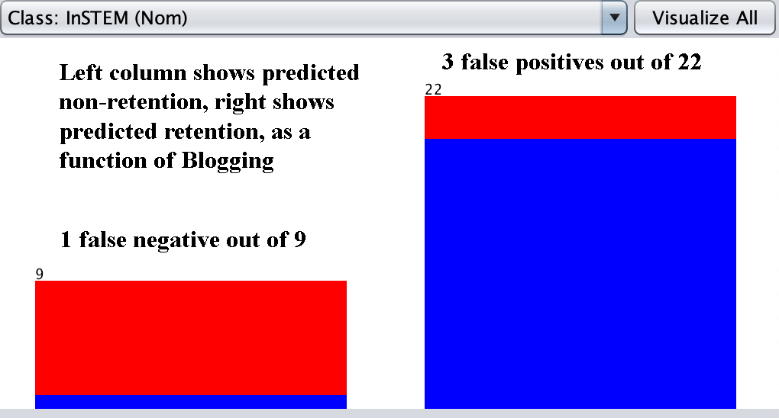
2D Visualization for OneR BlogPosts model

Slide 17
BlogPosts as a measurement device
This measure is objective, not an opinion. They posted, or they didn’t.
In addition to being a very accurate predictor at 87 to 93%, it is a very early predictor. Scholars were instructed at the start of the program and at the start of each semester:
  “Welcome back to another semester! For a few of you, your last semester!! This is a reminder that as a CARE scholarship recipient you have certain responsibilities. Some of these are maintaining a journal (blog), updating your resume annually, and working with mentors. Also, make sure you have signed the consent form. If you haven’t, or aren’t sure if you did, please stop by my office asap.”
Blog posting is not enforced by grades or other levers.
Is it a measure of motivation? Basic willingness to follow instructions?

Slide 18
OneR rule for Interview Attendance
Attended at least one end-of-year interview, conducted by GA, maps to -> retention in the program:
Y -> Y (Attended Interview predicts retention.)
N -> N (Non-attendance predicts non-retention.)
Y N <-- classified as InSTEM
17 3 | Y actually still InSTEM
6 5 | N no longer InSTEM
Objective but late measure, 22/31 = 71% accurate, 22/29 = 76%

Slide 19
OneR rule for “Was Blog Useful?”
Attended Interview and answered question “Was Blog Useful?”:
Y -> Y (Answered Yes predicts retention.)
N -> Y (Answered No predicts retention.)
? -> N (Did not attend interview -> non-retention.)
Y N <-- classified as InSTEM
17 3 | Y actually still InSTEM
6 5 | N no longer InSTEM
Subjective, late measure, 22/31 = 71%, actual answer was irrelevant.

Slide 20
Acceptance, Retention by Demographic
 | Accepted | % of 31 | Retained | %accepted
Female | 19 | 61.29% | 13 | 68.42%
Black | 10 | 32.26% | 4 | 40.00%
Hispanic | 2 | 6.45% | 1 | 50.00%
Asian | 1 | 3.23% | 1 | 100.00%
White | 17 | 54.84% | 13 | 76.47%
DNR | 1 | 3.23% | 1 | 100.00%

Slide 21
Measures for 3 Largest Demographics
 | Female | Black | White
Blogged | 15/19 (79%) | 4/10 (40%) | 16/17 (94%)
Interviewed | 14/19 (74%) | 7/10 (70%) | 14/17 (82%)
Fit | 3.039 | 3 | 3.509
Confident | 3.607 | 3 | 3.738
UseTutors | 10/12 (83%) | 4/10 (40%) | 11/17 (65%)
UseMentors | 11/14 (79%) | 3/10 (30%) | 12/17 (71%)
Interned | 2/19 (11%) | 3/10 (30%) | 1/17 (6%)
MathSAT | 518 | 488 | 531
HSGPA | 3.462 | 3.19 | 3.49
ALEKS | 68 | 57 | 65
Retained | 68.42% | 40% | 76.47%

Slide 22
Naïve Bayes statistical model most accurate
Kappa statistic 0.7748
Y N <-- classified as InStem
20 0 | Y actually still InSTEM
3 8 | N no longer InSTEM
After removal of status (redundant with InSTEM) and KU GPA (after classes & trivial predictor).
No false negatives, 28/31 = 90.3%, 28/30 for medical = 93.3%
Statistical combination of all objective & subjective attributes.
Bayes correlation tables give clues for relations to examine in detail.

Slide 23
Acceptance, Retention by Year of Program
YearJoined | 1 | 2 | 3 | 4
CountJoined | 8 | 9 | 7 | 7
Retained | 60.00% | 44.44% | 100.00% | 71.43%
NumberIn | 8 | 14 | 19 | 20
NumberOut | 5 | 12 | 15 | 18
StayedIn | 62.50% | 85.71% | 78.95% | 90.00%
WhyNot | Drop | Drop,GPA | Drop,GPA,Med | Drop,GPA

Slide 24
Some Naïve Bayes correlations
Class (current scholars+graduated are InSTEM)
Attribute DropKU InSTEM DropSTEM LowGPA
(0.11) (0.6) (0.14) (0.14)
MathSAT
mean 518.18 556.82 463.64 518.18
ALEKS
mean 46.2 74.4 26.4 0

Slide 25
Gender in Multimedia Programming
In spring 2018 APD majors taking CSC[12]20
course | semester | female | students | %female
Intro | fall2015 | 1 | 16 | 6.25%
Intro | fall2016 | 10 | 21 | 47.62%
Intro | fall2017 | 12 | 43 | 27.91%
Intro | spring2018 | 26 | 53 | 49.06%
Intro | spring2019 | 26 | 68 | 38.24%
Intro | spring2020 | 40 | 78 | 51.28%
Advanced | spring2016 | 2 | 26 | 7.69%
Advanced | spring2017 | 6 | 40 | 15.00%
Advanced | fall2018 | 9 | 47 | 19.15%
Advanced | fall2019 | 9 | 46 | 19.57%

Slide 26
High School Girls in Computer Science
Girls in CS | schools | attendees | vendors | vendor attendees
Mar-17 | 5 | 71 | 10 | 17
Oct-17 | 6 | 75 | 14 | 25
Oct-18 | 6 | 97 | 14 | 31
Oct-19 | 10 | 165 | 12 | 31

Slide 27
Fairly Obvious Conclusions
With about 13% of the KU CSIT population being Women, and around 62% of CARE/STEM scholars being Women, we did a good job recruiting and supporting women.
  Our female scholars have been very good students.
With 9 to 10% of the KU CSIT population being Hispanic, but only about 6% of CARE/STEM scholars being Hispanic, we need to be more proactive in recruiting Hispanic scholars for similar programs.
With about 11% of the KU CSIT population being African-American, and a yearly mean of 40% of CARE/STEM scholars being African-American (median 36%), we did a good job recruiting, but with only 40% of these retained, we need to do better with retention.

Slide 28
Suggestions & Possible Interventions
Ask for (but do not mandate) blogs for incoming scholars (majors?).
Require incoming ALEKS scores.
Do an early requested (not mandated) interview with a GA.
  Not faculty – this might apply more pressure to attend.
Use above measures as indicators of at-risk students.
Mandate class & tutor attendance for at-risk scholars?
  Funds already contingent on GPA.
Require non-bloggers-interview attendees to organize an event?
  Such activities take time.

Slide 29
Other Interventions & Conclusions
Assoc. Dean candidate recommended getting funded project work for challenged STEM students so they don’t have to hold down jobs.
ACM 2015 in-depth report suggests activities & interventions, many of which we are doing.
There have to be carrots in addition to sticks, but there have to be responsibilities and consequences for scholars.
We did not hit our 80% retention goals (65%) but we may have learned more about what works & fails by having a more representative population of scholars.
How to apply these lessons to CSIT majors is an open question.

