Slide 1
Study Guide for CPSC223 Take-Home Final Exam, Fall 2024
Dale E. Parson, Ph.D.
Retired Bell Labs Distinguished and Consulting Member of Technical Staff
Professor of Computer Science & Data Science
Kutztown University of PA

Slide 2
Pearsonr measures linear relationships
1.0 means paired sequences perfect positive linear correlation
-1.0 means paired sequences perfect negative linear correlation
  As one sequence goes up, the other goes down linearly.
0.0 means no linear correlation
from scipy.stats import pearsonr, spearmanr
https://docs.scipy.org/doc/scipy-1.14.1/reference/generated/scipy.stats.pearsonr.html
  Read the first paragraph.

Slide 3
Spearmanr measures monotonic relationships
1.0 means paired sequences change in the positive, negative, or flat direction in step without regard to magnitude of change.
-1.0 means paired sequences change in opposite directions.
0.0 means no monotonic correlation w.r.t. direction of change.
from scipy.stats import spearmanr
https://docs.scipy.org/doc/scipy-1.14.1/reference/generated/scipy.stats.spearmanr.html#scipy.stats.spearmanr
  Read the first paragraph.

Slide 4
Mean absolute error averages distance between respective pairs of samples.
Sum the absolute value of the differences between respective samples, then divide by number of samples.
  Absolute value eliminates negative signs in distance calculations.
def mae(seq1, seq2):
  diffs = [abs(seq1[ix]-seq2[ix]) for ix in range(len(seq1))]
  result = round(sum(diffs)/len(diffs), 6)
  return result # Normally I used the library function.
  https://scikit-learn.org/1.5/modules/generated/sklearn.metrics.mean_absolute_error.html
  https://scikit-learn.org/1.5/modules/model_evaluation.html#mean-absolute-error
  Read the first paragraph.

Slide 5
Mean squared error averages distance^{(squared)} between respective pairs of samples.
Sum the square of the differences between respective samples, then divide by number of samples.
  Squaring emphasizes high-magnitude outliers in either direction.
def mse(seq1, seq2):
  diffs = [(seq1[ix]-seq2[ix])**2 for ix in range(len(seq1))]
  result = round(sum(diffs)/len(diffs), 6)
  return result # Normally I used the library function.
  https://scikit-learn.org/1.5/modules/generated/sklearn.metrics.mean_squared_error.html#sklearn.metrics.mean_squared_error
  https://scikit-learn.org/1.5/modules/model_evaluation.html#mean-squared-error
  Read the first paragraph.

Slide 6
Root mean squared error averages distance^{(squared)} between respective pairs of samples, then applies sqrt.
Recent versions of the scikit library define root_mean_squared_error.
  The square root scales the difference back into the original range of samples.
  RMSE still emphasizes high-magnitude outliers in either direction.
def rmse(seq1, seq2):
  return round(sqrt(mse(seq1, seq2)), 6)
  # Normally I used the library function in recent versions..
  https://scikit-learn.org/1.5/modules/generated/sklearn.metrics.root_mean_squared_error.html#sklearn.metrics.root_mean_squared_error
  Python doc links to mean_squared_error.

Slide 7
Know your Assignment 4 statistics measures
from statistics import mean, median, mode, multimode, quantiles
https://docs.python.org/3/library/statistics.html
mean takes the sum/count (a.k.a. “average”).
median takes the value in the middle of a sorted sequence.
  For an even number of values it takes the mean of the two straddling the center.
mode takes the most frequently occurring value.
  When there is a tie, old versions raise an exception; newer versions return an arbitrary value from the tied values.
multimode in newer versions return a list of all tied values.
quantiles returns the 25%, 50%, and 75% values of sorted sequence.
  quantiles is available in newer versions of stats. It supports other cut points.

Slide 8
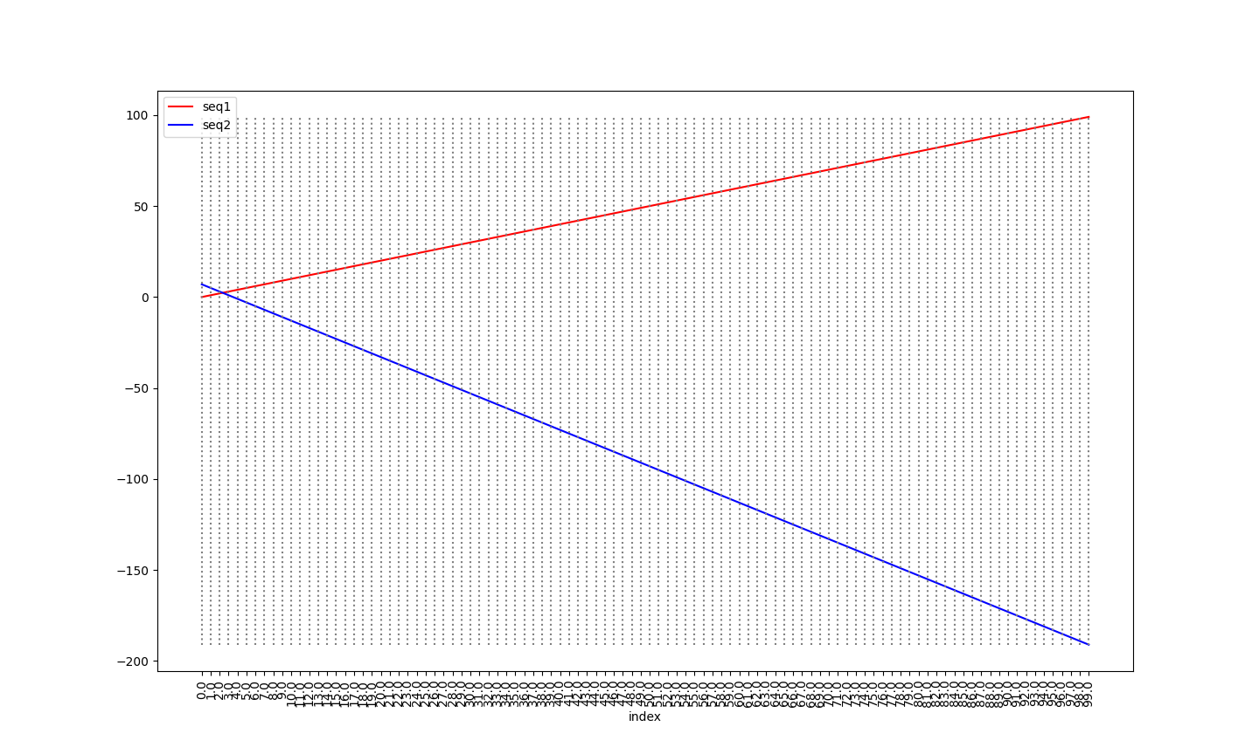
linear100 = [i for i in range(0,100)] linearNX2p7= [-e*2+7 for e in linear100]

Slide 9
Measures for linear100 and linearNX2p7
In [15]: min(linearNX2p7) -> Out[15]: -191
In [16]: max(linearNX2p7) -> Out[16]: 7
In [17]: linearNX2p7[0:10]
  -> Out[17]: [7, 5, 3, 1, -1, -3, -5, -7, -9, -11]
In [18]: linearNX2p7[-10:]
  -> Out[18]: [-173, -175, -177, -179, -181, -183, -185, -187, -189, -191]

Slide 10
More measures for linear100 & linearNX2p7
In [19]: quantiles(linearNX2p7) -> Out[19]: [-142.5, -92.0, -41.5]
In [20]: quantiles(sorted(linearNX2p7))
  -> Out[20]: [-142.5, -92.0, -41.5]
In [25]: quantiles(linearNX2p7, n=10)
  -> Out[25]: [-172.8, -152.6, -132.4, -112.2, -92.0, -71.8, -51.6, -31.4, -11.2]
In [21]: (mean(linearNX2p7), median(linearNX2p7), mode(linearNX2p7))
  -> Out[21]: (-92, -92.0, 7)
In [23]: len(multimode(linearNX2p7)) -> Out[23]: 100

Slide 11
Examples plot sample sequences.
def dump(filename,seq1,seq2):
  f = open(filename + '.csv', 'w', newline='')
  fcsv = csv.writer(f, delimiter=',')
  fcsv.writerow(['index', 'seq1', 'seq2'])
  for ix in range(0, min(len(seq1), len(seq2))):
    fcsv.writerow([ix, seq1[ix], seq2[ix]])
  f.close()

Slide 12
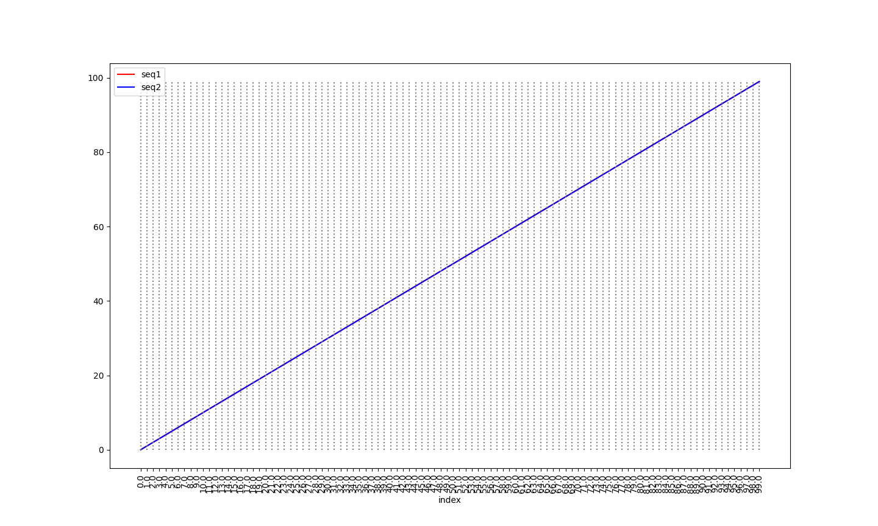
linear100 = [i for i in range(0,100)] for both sequences

Slide 13
Measures for linear100 page #1
In [31]: round(pearsonr(linear100, linear100)[0],6)
Out[31]: 1.0
In [32]: round(spearmanr(linear100, linear100)[0],6)
Out[32]: 1.0
In [35]: round(mean_absolute_error(linear100, linear100),6)
Out[35]: 0.0
In [36]: round(root_mean_squared_error(linear100, linear100),6)
Out[36]: 0.0

Slide 14
Measures for linear100 page #2
In [40]: from statistics import StatisticsError
In [42]: for f in (min, max, mean, median, mode):
...: try:
...: print(f, round(f(linear100),6))
...: except StatisticsError as oops:
...: print(f, None, oops)
...:
<built-in function min> 0
<built-in function max> 99
<function mean at 0x121b94050> 49.5
<function median at 0x121b94170> 49.5
<function mode at 0x121b943b0> None no unique mode; found 100 equally common values

Slide 15
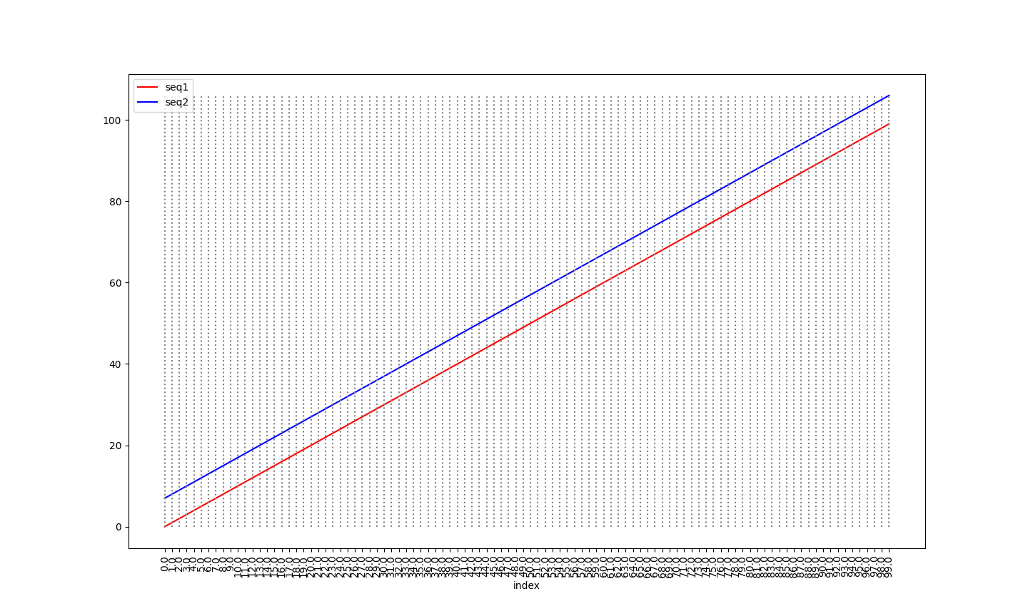
linear100 as before linearp7= [e+7 for e in linear100]

Slide 16
Measures for linear100, linearp7
In [31]: round(pearsonr(linear100, linearp7)[0],6)
Out[31]: 1.0
In [32]: round(spearmanr(linear100, linearp7)[0],6)
Out[32]: 1.0
In [35]: round(mean_absolute_error(linear100, linearp7),6)
Out[35]: 7.0
In [36]: round(root_mean_squared_error(linear100, linearp7),6)
Out[36]: 7.0

Slide 17
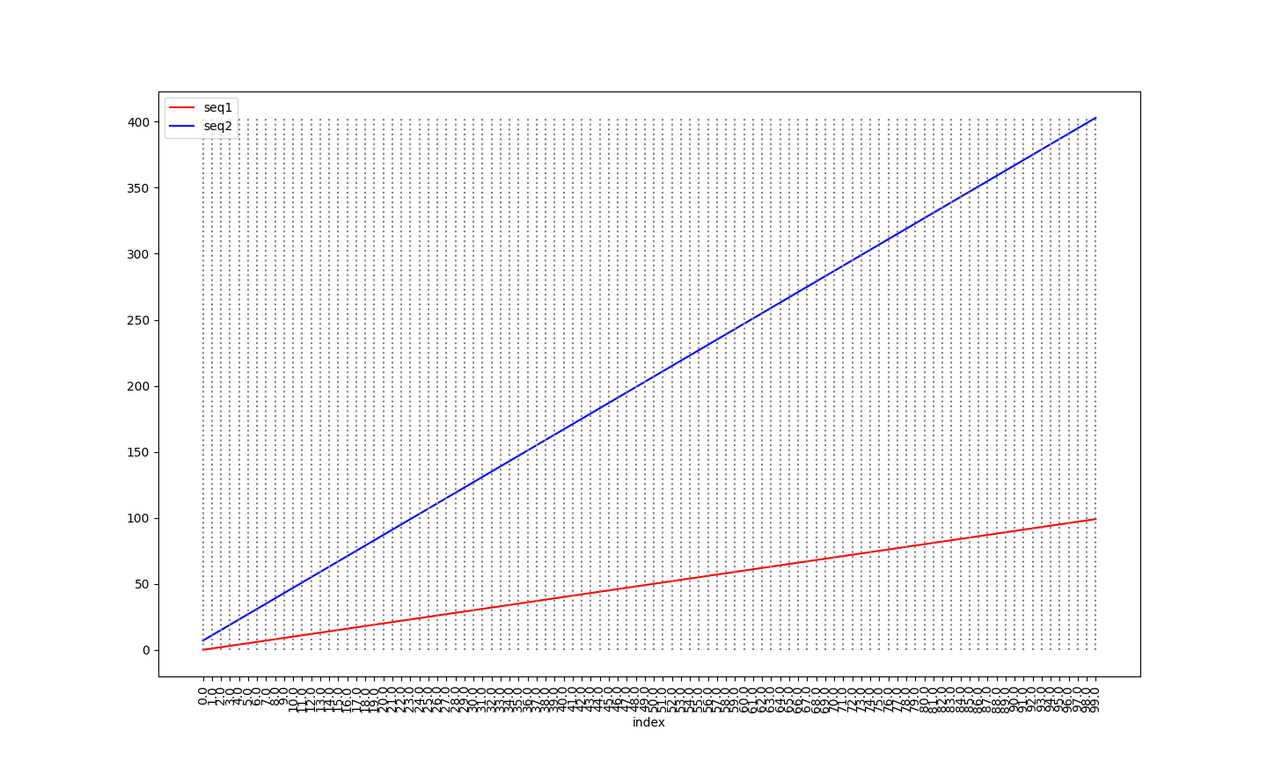
linear100 as before linearX4p7= [e*4+7 for e in linear100]

Slide 18
Measures for linear100, linearX4p7
In [31]: round(pearsonr(linear100, linearX4p7)[0],6) -> Out[31]: 1.0
In [32]: round(spearmanr(linear100, linearX4p7)[0],6) -> Out[32]: 1.0
In [35]: round(mean_absolute_error(linear100, linearX4p7),6)
Out[35]: 155.5
In [36]: round(root_mean_squared_error(linear100, linearX4p7),6)
Out[36]: 177.987359
In [58]: median(linearX4p7) - median(linear100)
Out[58]: 155.5 # Note: They are two lines with slopes of 1 and 4 respectively, starting at about the same value, so we can just pick out the diff in the center for MAE.

Slide 19
linear100 = [i for i in range(0,100)] linearNX2p7= [-e*2+7 for e in linear100]

Slide 20
Measures for linear100, linearNX2p7
In [31]: round(pearsonr(linear100, linearNX2p7)[0],6) -> Out[31]: -1.0
In [32]: round(spearmanr(linear100, linearNX2p7)[0],6) -> Out[32]: -1.0
In [35]: round(mean_absolute_error(linear100, linearNX2p7),6)
Out[35]: 141.74
In [36]: round(root_mean_squared_error(linear100, linearNX2p7),6)
Out[36]: 165.896052
  Slightly less than linearX4p7’s 155.5, 177.987359 because they cross (dist=0).
In [66]: median(linearNX2p7) - median(linear100) -> Out[66]: -141.5

Slide 21
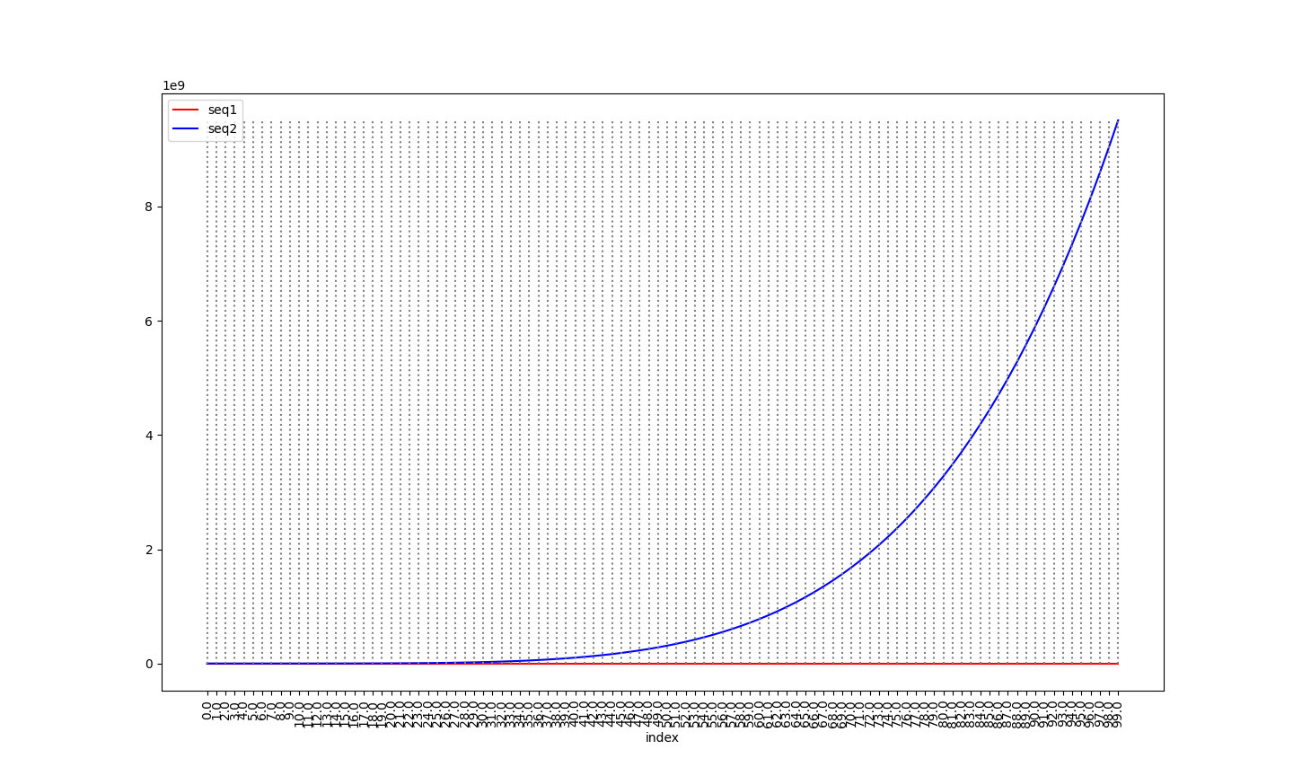
linear100 as before, power relationship: linearRaised5= [e**5 for e in linear100]

Slide 22
Measures for linear100, linearRaised5
In [31]: round(pearsonr(linear100, linearRaised5)[0],6) -> Out[31]: 0.8194
In [32]: round(spearmanr(linear100, linearRaised5)[0],6) -> Out[32]: 1.0
In [35]: round(mean_absolute_error(linear100, linearRaised5),6)
Out[35]: 1,617,083,275.5
In [36]: round(root_mean_squared_error(linear100, linearRaised5),6)
Out[36]: 2,932,446,273.766689
In [70]: max(linearRaised5) -> Out[70]: 9,509,900,499
  In [72]: 10*10**9 -> Out[72]: 10,000,000,000 on the graph.

Slide 23
Invertible relationships may become linear.
In [113]: linearUnRaised5 = [round(e**0.2) for e in linearRaised5]
In [114]: linearUnRaised5 == linear100
Out[114]: True
Using the fifth root in this case.
You need to know the parameters of the inverse function.
  For example, e**0.2 inverts e**5.
If you know them, you can always recover the original values.
In [115]: round(pearsonr(linear100, linearUnRaised5)[0],6)
Out[115]: 1.0

Slide 24
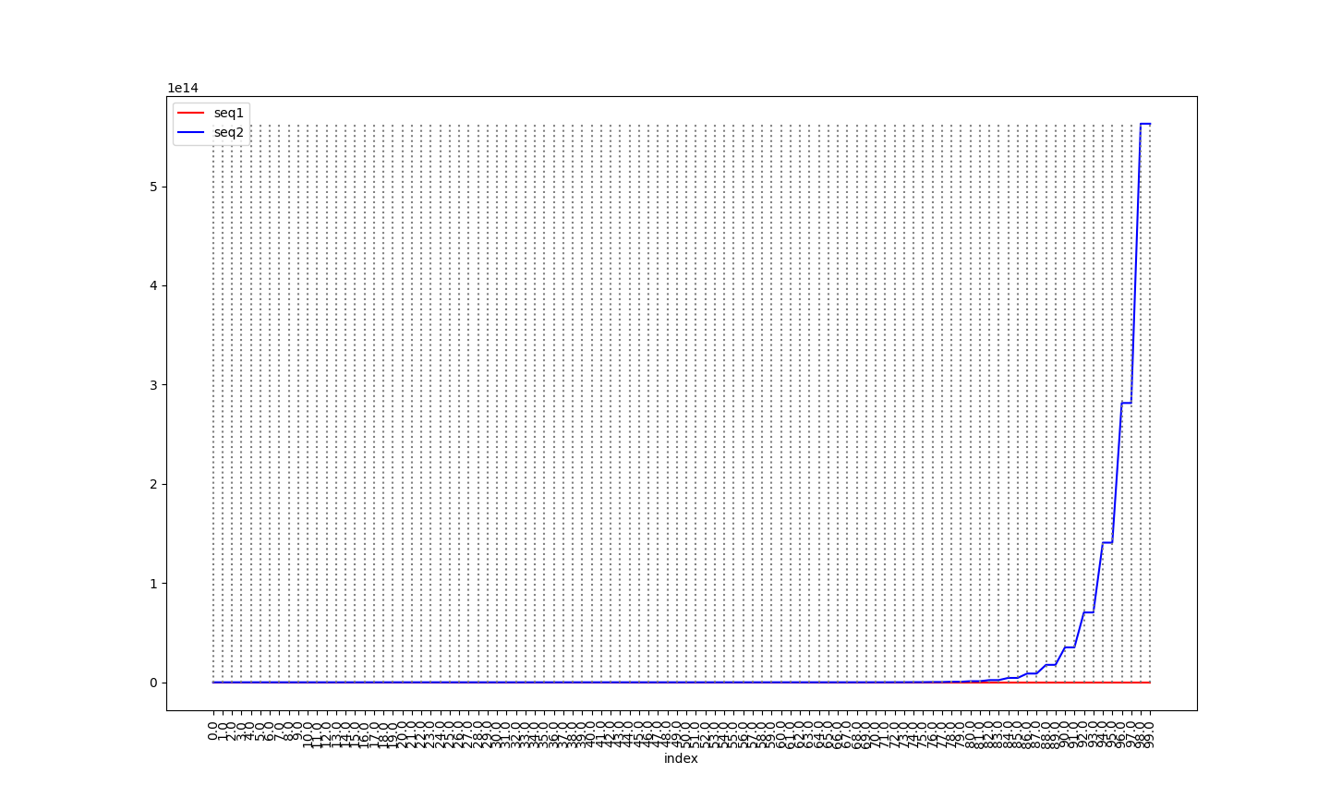
linear100 as before, exponential relationship: linearExpHalf2= [(2**(e//2))for e in linear100]

Slide 25
Measures for linear100, linearExpHalf2
In [31]: round(pearsonr(linear100, linearExpHalf2)[0],6) -> Out[31]: 0.41136
In [32]: round(spearmanr(linear100, linearExpHalf2)[0],6) -> Out[32]: 0.99985
In [35]: round(mean_absolute_error(linear100, linearExpHalf2),6)
Out[35]: 22,517,998,136,803.0
In [36]: round(root_mean_squared_error(linear100, linearExpHalf2),6)
Out[36]: 91,929,342,440,361.14
In [70]: max(linearExpHalf2) -> Out[70]: 562,949,953,421,312
In [117]: linearExpHalf2[0:10]
Out[117]: [1, 1, 2, 2, 4, 4, 8, 8, 16, 16]

Slide 26
Invertible relationships may become linear.
In [133]: linvert = [int(log2(linearExpHalf2[ix])*2) for ix in range(len(linearExpHalf2))]
In [134]: linvert[0:10]
Out[134]: [0, 0, 2, 2, 4, 4, 6, 6, 8, 8]
In [135]: linvert = [int(log2(linearExpHalf2[ix])*2+(ix%2)) for ix in range(len(linearExpHalf2))]
In [136]: linvert[0:10]
Out[136]: [0, 1, 2, 3, 4, 5, 6, 7, 8, 9]
In [138]: linvert == linear100
Out[138]: True
You need to know the parameters of the inverse function.
If you know them, you can always recover the original values.

Slide 27
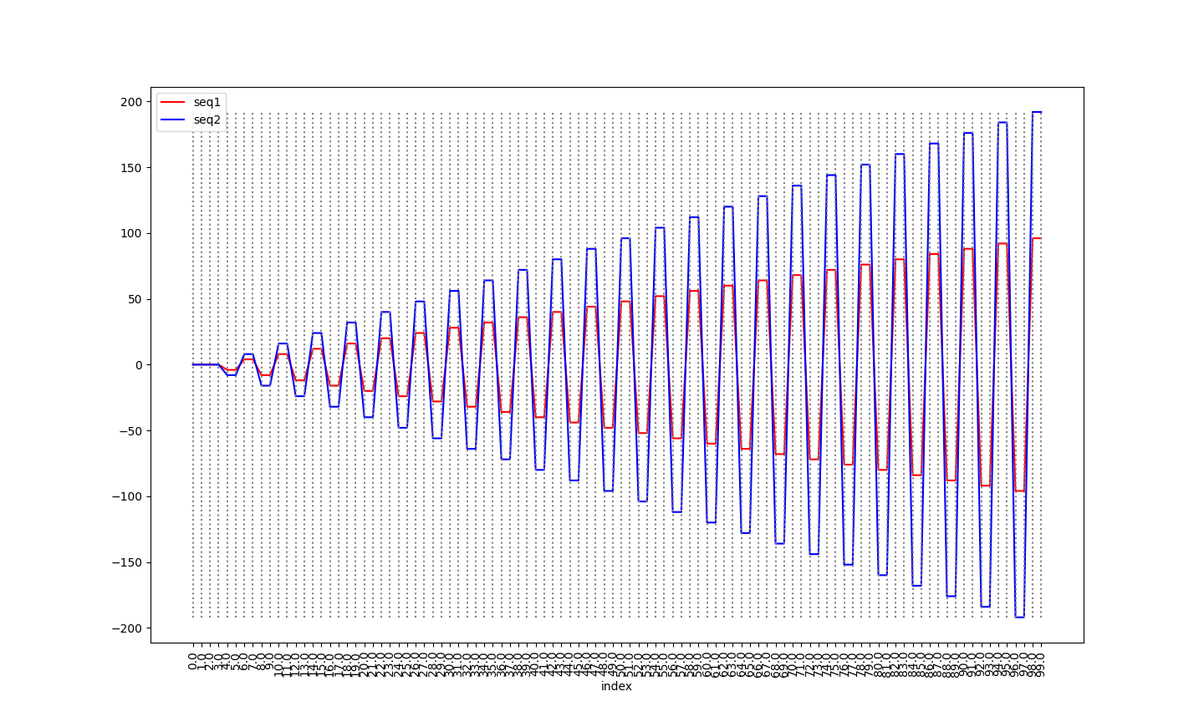
step4 = [linear100[ix]//4*4 * (-1 if ((ix%4) < 2) else 1) for ix in range(len(linear100))] step8 = [linear100[ix]//4*8 * (-1 if ((ix%4) < 2) else 1) for ix in range(len(linear100))]

Slide 28
Measures for step4, step8
In [183]: step4[0:12] -> Out[183]: [0, 0, 0, 0, -4, -4, 4, 4, -8, -8, 8, 8]
In [184]: step8[0:12] -> Out[184]: [0, 0, 0, 0, -8, -8, 8, 8, -16, -16, 16, 16]
In [191]: min(step4) -> Out[191]: -96
In [188]: max(step4) ->Out[188]: 96
In [190]: min(step8) -> Out[190]: -192
In [189]: max(step8) -> Out[189]: 192
In [192]: median(step4) -> Out[192]: 0.0
In [193]: median(step8) -> Out[193]: 0.0
In [194]: mode(step4) -> Out[194]: 0
In [195]: mode(step8) -> Out[195]: 0 # Likewise mean == 0

Slide 29
Correlations and diffs for step4, step8
In [198]: round(pcc(step4, step8),6) -> Out[198]: 1.0
In [199]: round(scc(step4, step8),6) -> Out[199]: 1.0
In [200]: round(mae(step4, step8),6) -> Out[200]: 48.0
In [202]: round(rmse(step4, step8), 6) -> Out[202]: 56.0
These are linearly correlated and invertible.
In [207]: step8DIV2 = [ele//2 for ele in step8]
In [208]: step8DIV2 == step4 -> Out[208]: True
These are not simple lines.
  In [209]: round(pcc(step4, linear100),6) -> Out[209]: 0.029694
  In [210]: round(scc(step4, linear100),6) -> Out[210]: 0.02996

Slide 30
Seed values for pseudo-random number generators
Assignment 1 in ~parson/Scripting/CSC223f24SORTassn1 uses these.
https://docs.python.org/3/library/random.html#random.randint
https://numpy.org/doc/stable/reference/random/generated/numpy.random.exponential.html
  The purpose of seeding a pseudo-random generator is so that it produces the same sequence of values on each run. This repeatability is often used for testing, comparing program output to a previous run’s output. Seeding guarantees the same, repeatable sequences of values.
https://docs.python.org/3/library/random.html#random.seed
https://numpy.org/doc/stable/reference/random/generator.html#numpy.random.default_rng
https://numpy.org/doc/stable/reference/random/bit_generators/index.html#seeding-and-entropy

Slide 31
Normalization is useful to get sequence of values into a standardized range
In [1]: def normMinToMax(seq1):
...: ''' Normalize values as decimal percentage from min to max. '''
...: mn = min(seq1)
...: mx = max(seq1)
...: __range__ = mx - mn
...: result = [round((v-mn) / __range__, 6) for v in seq1]
...: return result

Slide 32
Normalization is useful to get sequence values into a standardized range
In [3]: normLinear100 = normMinToMax(linear100)
In [4]: normLinear100[0:10] -> Out[4]:
  [0.0, 0.010101, 0.020202, 0.030303, 0.040404,
  0.050505, 0.060606, 0.070707, 0.080808, 0.090909]
In [5]: normLinear100[-10:] -> Out[5]:
  [0.909091, 0.919192, 0.929293, 0.939394, 0.949495,
  0.959596, 0.969697, 0.979798, 0.989899, 1.0]

Slide 33
Assn2 uses normalization to get values into
[-32768, 32767] signed 16-bit WAV file values.
def __normalize__(floatvalues, gain):
minvalue = (min(floatvalues))
maxvalue = (max(floatvalues))
range = (maxvalue - minvalue)
normed = []
for cell in floatvalues:
newcell = (cell - minvalue) / range # [0.0, 1.0]
newcell = int(newcell * 65535 - 32768) # [-32768,32767]
newcell = int(gain * newcell)
newcell = max(newcell, -32767)
normed.append(np.int16(newcell))
return normed

Slide 34
Assn3 Python closures allow an outer function to bind parameters & variables “permanently” after it returns for use by an inner (closure) function. (CSC223f24DeriveAssn3.py)
def delta(Nstring):
N = int(Nstring)
if N < 1:
raise ValueError('Invalid N value to delta: ' + str(Nstring))
history = []
def deltaClosure(cell):
while len(history) > N:
history.pop(0)
if len(history) == N:
result = round(cell - history[0],3)
else:
result = None
history.append(cell)
return result
# return deltaClosure from delta.
return deltaClosure

Slide 35
Generators act like separate “cooperative threads” that remain active across yield commands that yield values.
We used them in a PULL and a PUSH dataflow architecture.
In [3]: def genxY(count):
...: for i in range(0,count):
...: if (i & 1) == 0: # even number
...: yield('x')
...: else:
...: yield('Y')
...:
In [4]: for v in genxY(10):
...: print(v)
...:
x
Y
x
Y
x
Y
x
Y
x
Y

