Slide 1
Analyzing Education and Poverty’s Impact on Violent Crime Rates in Pennsylvania
By: Yelitza Pagan
Notes:
Hello today I will be presenting analyzing education and poverty’s impact on violent crime rates in Pennsylvania

Slide 2
Where is the Data From?
Notes:
Second Slide
So first before we start analyzing the data we need to understand the data I am working with because there were adjustments that needed to be made in order to properly compare the Viollent Crime data with Education and Poverty rates. Let’s start off where the data is from. I am using education and poverty data that has been collected by the US Census. I am also utilizing Pennsylvania Uniform Crime Reporting System to collect the total of violent crimes per county. This data is compiled and maintained by the Pennsylvania State Police.
The data that was collected spans from 2017 to 2021.

Slide 3
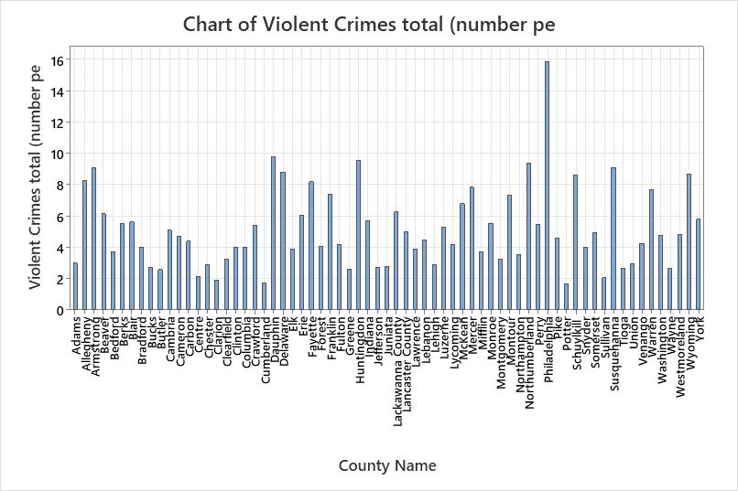
Violent Crime Data
Notes:
Third Slide
Violent crimes, per Pennsylvania Uniform Crime Reporting System, are crimes such as Murder/Non negligent Homicide, Rape, Robbery, and Aggravated Assault. I transformed the data to have the number of violent crimes be based on 100,000 people. This allows for more accurate reporting for counties that may have a smaller population. Here is a simple bar graph that shows the number of violent crime per 100,00 in each county. Here you can see Philadelphia County has the highest number of violent crimes white Dauphin county coming in second.

Slide 4
US Census Data
Notes:
The data collected for education is based only based on those graduating high school or higher.
The data collected for poverty, is based off of a five-year estimate which was specified when I collected the data.

Slide 5
Cleaning
Notes:
Sixth Slide
Collecting the data from two different sources proved to be a bit challenging to get that all together. Both the sources I used made it extremely difficult to gather large chunks of data at a time. Collecting data from the Pennsyulvania Uniform Crime Reporting System result in 67 excel spreadsheets, each which everytime I downloaded the file I needed to rename in my folder, to ensure that I did not have any duplicate counties by mistake because when downloading the data they all saved with the same name. The US Census data resulted in 14 spreadsheets for education and poverty rates, and so much data that also came along for the US Census data. Which was 64 extra lines of data that I did not need. This took a bit to clean up as I needed to get all the data into one excel spreadsheet and clean up data that I did not plan on utilizing. It was a very time consuming process. But eventually I was able to get all the data into one spreadsheet.

Slide 6
Multiple Linear Regression
Notes:
So here I took two factors, which was high school graduate or higher and the percent of people in poverty. I thought there would be a significance which is why I ran multiple regression on the two variables.
It turns out as you can see here that only poverty is significant. You can tell this by the P-Value. The P-Value is used to determine the factors significance level. As you can see here the P-value for Persons in poverty is 0.015 which falls into the range that makes the factor statistically significant.

Slide 7
Linear Regression
Notes:
So as mentioned the factor persons in poverty was considered the most significant so I ran linear regression on just that data. If you noticed in my last slide the R-sq adjusted was 6.11 percent. When just including this one variable you can see the r-sq adjusted is higher. This shows that it is a stronger model with just the one variable. To explain this further when comparing violent crimes to poverty you can see for every percent of the population that lives in poverty, you can expect about .257 violent crimes per 100,000 or to put it simply per this model you can expect 1 violent crime for every 4 percent of the population that lies in poverty. Fpr example if 12% of this county lives in poverty you can expect there to be 3 violent crimes per 100,000.
You can take note of the R-sq adjusted as 6.11 in the last slide. When just including the one variable you can see the r-sq adjusted is higher. Which shows that it is a stronger model. So this model can explain 6.62% of the variation in violent crime rates.

Slide 8
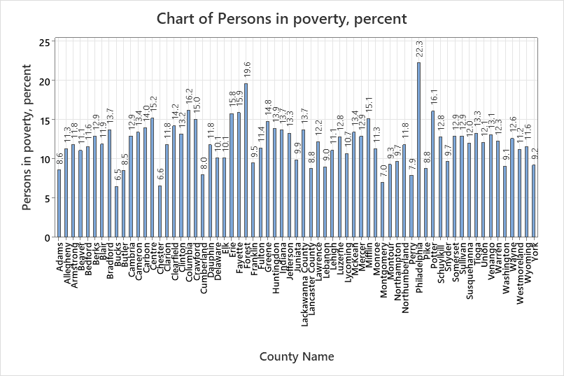
Notes:
The amount of people in poverty is 22.3% in Philadelphia county as mentioned previously for every 4% of the population in poverty we can expect at least 1 violent crime per 100,00 and because there is 22.3% people living in poverty you can expect 5.57 violent crimes per 100,000 plus 2 because of the constant so Philadelphia does not fit the model.
Berks is 12,9% in poverty, you can expect 3.225 violent crimes plus 2 as the constant so about 5 .225 violent crimes per 100,000 so berks fits the model very well as there are about six violent crimes per 100,000

Slide 10
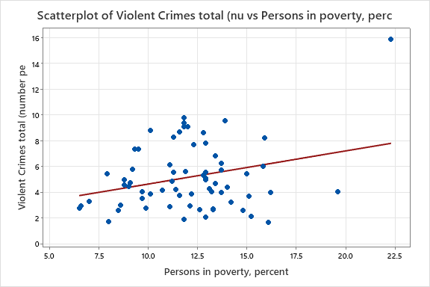
Notes:
Correlation coefficient is 0.284 which means it is a weak to moderate correlation between the two variables. Also what is interesting as I mentioned that Philadelphia does not fit the model well. This is a visual representation of that. We can see that Philadelphia is very far away from the line of best fit.

Slide 11
How can the results be used?
Notes:
The results show that poverty can be linked and result in violent crimes. Using public funding to assist people in poverty can take place in various forms. For example, public funding could be better utilized for funding affordable housing, providing more access to skill developments to allow people to gain skills that they can use in a higher paying career and break out of generational poverty, and expanding access to affordable healthcare. This is just a few examples on where public funding can help those who are struggling while also helping those who are victims or are in areas where violent crime is more repent.

