Slide 1
World Happiness
By: Kelly Fox

Slide 2
Overview
Analysis on the World Happiness Reports of 2015, 2016, 2017, 2018 and 2019.

Slide 3
Where is This Data From?
Kaggle.com
Gallup World Poll (GWP)
According to Gallup World Poll, the sample size is 1,000 people per country

Slide 4
Why I Chose this Dataset…
Intrigued me
How exactly does one measure happiness?
Happiness is important for well being
health, decisions, relationships, work and goals
Relatable – thinking about your own happiness

Slide 5
How is Happiness Scored?
Cantril Ladder:
“Please imagine a ladder, with steps numbered from 0 at the bottom to 10 at the top. The top of the ladder represents the best possible life for you and the bottom of the ladder represents the worst possible life for you. On which step of the ladder would you say you personally feel you stand at this time?”

Slide 6
Attributes After Cleaning
Rank
Country/Region
Economy
Social Support
Healthy Life Expectancy
Freedom to Make Life Choices
Generosity
Perceptions of Corruption
Happiness Score

Slide 7
How Are They Scored?
Rank – highest happiness score by country to lowest.
Country/Region – Name
Economy/GDP – Gross Domestic Product (GDP)-per-capita time series from the year using country- specific forecasts of real GDP growth
Social Support – binary responses (either 0 or 1) to the GWP question “If you were in trouble, do you have relatives or friends you can count on to help you whenever you need them, or not?”

Slide 8
How Are They Scored? (cont.)
Healthy Life Expectancy – data extracted from the World Health Organization’s (WHO) Global Health Observatory data repository.
Freedom to Make Life Choices – question: “Are you satisfied or dissatisfied with your freedom to choose what you do with your life?”
Generosity – question: “Have you donated money to a charity in the past month?”

Slide 9
How Are They Scored? (cont.)
Perceptions of Corruption – average of the survey responses to two questions: “Is corruption widespread throughout the government or not” and “Is corruption widespread within businesses or not?” The overall perception is just the average of the two responses.
Happiness Score – This is the average response to the question of life evaluations which are above.

Slide 10
First Steps
Change a .csv to .arff
Clean the data – got rid of and renamed some attributes
Made the happiness score the target attribute
Removed the attributes country/region and rank

Slide 11
Linear Regression
LinearRegression for each year:
2015:
Correlation coefficient 0.8668
2016:
Correlation coefficient 0.8781
2017:
Correlation coefficient 0.886
2018:
Correlation coefficient 0.8693
2019:
Correlation coefficient 0.8713

Slide 12
Results of LinearRegression ran on each attribute with the target attribute happiness score, the following is their correlation coefficients results:
 | 2015 | 2016 | 2017 | 2018 | 2019
Economy | 0.77 | 0.78 | 0.81 | 0.80 | 0.79
Social Support | 0.72 | 0.73 | 0.75 | 0.74 | 0.77
Life Expectancy | 0.72 | 0.76 | 0.77 | 0.77 | 0.77
Freedom | 0.55 | 0.55 | 0.55 | 0.53 | 0.55
Generosity | 0.08 | -0.076 | -0.02 | -0.07 | -0.34
Perceptions of Corruption | 0.35 | 0.37 | 0.39 | 0.35 | 0.35

Slide 13
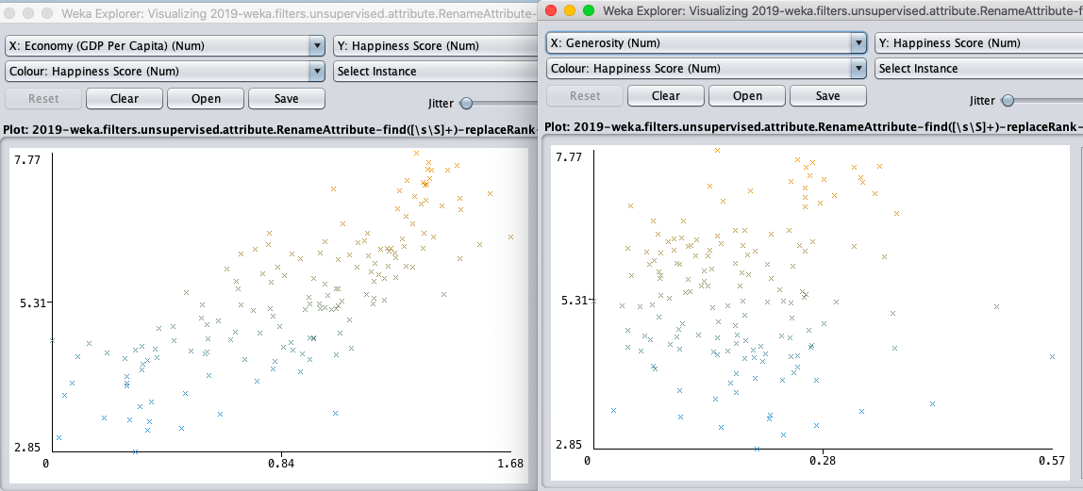
2019 LinearRegression Visualization
Economy and Happiness Score:
.79
Generosity and Happiness Score:
-0.34

Slide 14
Other Attribute: CorrelationAttributeEval
 | 2015 | 2016 | 2017 | 2018 | 2019
Ranked 1st | Economy (GDP per Capita) 0.781 | Economy (GDP per Capita) 0.79 | Economy (GDP Per Capita) 0.812 | Economy (GDP Per Capita) 0.802 | Economy (GDP Per Capita) 0.7939
Ranked 2nd | Social Support 0.741 | Social Support 0.739 | Social Support 0.753 | Social Support 0.746 | Social Support 0.7771
Ranked 3rd | Life Expectancy 0.724 | Life Expectancy 0.765 | Life Expectancy 0.782 | Life Expectancy 0.776 | Life Expectancy 0.7799
Ranked 4th | Freedom 0.568 | Freedom 0.567 | Freedom 0.57 | Freedom 0.544 | Freedom 0.5667
Ranked 5th | Generosity 0.18 | Generosity 0.157 | Generosity 0.155 | Generosity 0.136 | Generosity 0.0758
Ranked 6th | Perceptions of Corruption 0.395 | Perceptions of Corruption 0.402 | Perceptions of Corruption 0.429 | Perceptions of Corruption 0.392 | Perceptions of Corruption 0.3856

Slide 15
Who Can Use This? Future Uses
Country/Regions Governments
COVID-19

Slide 16
Best Countries - 2019
1. Finland
2. Denmark
3. Norway
……
19. United States

