Slide 1
Scripting and Extension Languages as Career Levers for CS&IT Graduates
Dr. Dale Parson, Research & Teaching Presentation, November 21, 2019

Slide 2
Overview
An extension language is a way to make dumb, batch-mode C/C++/Java applications interactive via language features, the Read-Eval-Print loop, and supported means for adding primitive commands to the language.
It provides means for scripting-savvy clients, including application shop I.I. support, to customize environments.
When done in a modular manner, it can allow you to pull infrastructure from one application type (e.g., data analysis) to another (such as visualization).

Slide 3
1994: Establishing Street Cred
Transferred from Design Automation Lab (tools for designing I.C.s and circuit boards) to DSP (digital signal processors for telephony) Tools Group, both part of AT&T Bell Labs in Allentown.
DSP application engineers would develop their code on C simulation models written by processor designers using Unix, but when it came time to test with a hardware processor, they had to use an MSDOS box hosting that debugger + hardware. They hated working with MSDOS.

Slide 4
My first project in DSP Software Tools, 1994
I partitioned the tool into a Debugger + Simulator that could run on Unix or MSDOS, and communicated via TCP/IP to a Win16 box hosting the hardware.
My first Windows programming, first TCP/IP, first DSP app.
Win16 had only 1 thread of control shared by the O.S. and applications. Time sharing requires explicit state saving by the app and thread handoff to the O.S.
PCs did not come with network interface cards (NIC). I had to certify NICs & Winsock16 TCP/IP libraries from separate vendors.

Slide 5
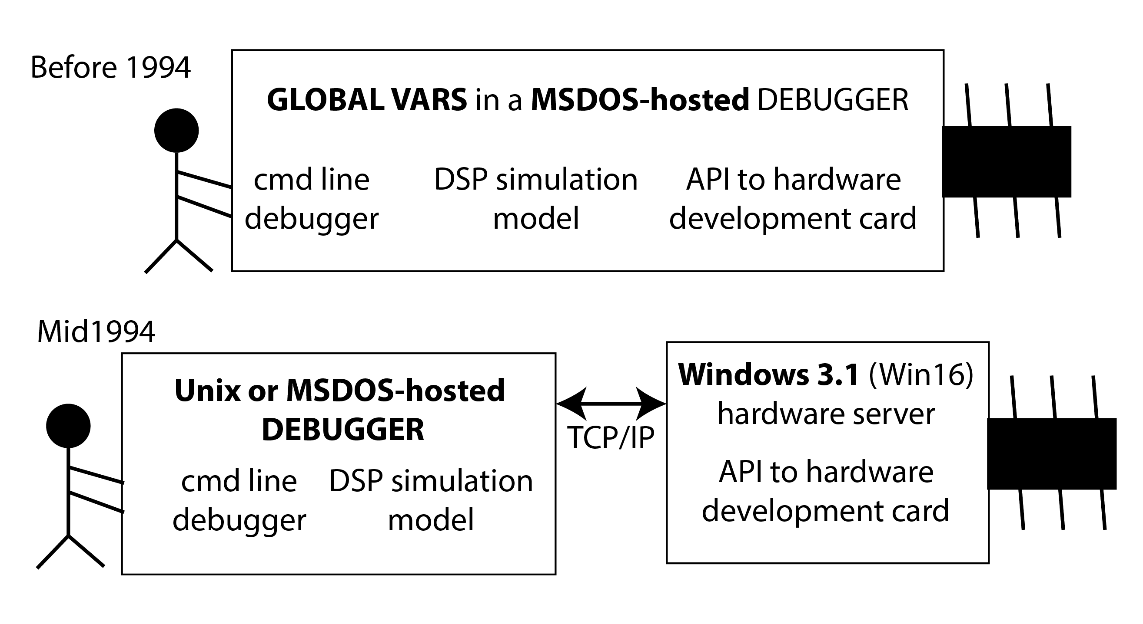
My first gig in DSP Software Tools, 1994, continued

Slide 6
Next assignment, start of 1995, architecting simulation models for new DSP architecture.
Bryan Schlieder, lead tools engineer: “Good, they’re putting you on this, you want take any ****.”
Me: “Good grief. What I have gotten myself into?”
A month later, Dept. Chair in meeting with my manager, me, and processor designers previously responsible for models: “What do you think we should do?”
“I wasn’t elected to represent my group.”
“No, but you could be. What should we do?”
We got control. And responsibility to deliver.

Slide 7
Architecting a processor simulation technology
U.S. Patent 6053947, “Simulation Model Using Object-Oriented Programming,” April 25, 2000, concerning an object-oriented event-driven simulation mechanism patterned after structural hardware design.

Slide 8
TCL – Tool Command Language Tcl Environment for Extensible Modeling
Bryan Schlieder: “Take a look at Tcl for the tool’s command interpreter.”
Already some Tcl experts in Bell Labs Allentown.
https://www.tcl.tk/
Based on BSD Unix C-shell syntax, but with support to add application specific commands in C/C++.
Our Tcl + custom commands can control the simulation model and hardware state machines, and query/update the state in those models.

Slide 9
Leveraging an extension language-based in the field
By 1998 there were about 20 developers + 10 support staff (testing & documentation) in Allentown on this project.
There were at least dozens of international field application engineers at customer sites extending our tools into build & test environments via Tcl.
The first embedded system toolset to distribute over TCP/IP both the simulator/debugger from its GUI (written in Tcl/Tk), and also the hardware from the simulator/debugger.
The day we turned on alpha hardware debugging for these new tools, application engineers in Allentown debugged a customer problem in England that evening.

Slide 10
Papers, patents, & illustrations … (Click the links, see the pictures.)
Parson, Beatty and Schlieder, “A Tcl-based Self-configuring Embedded System Debugger,” Proceedings of Fifth Tcl/Tk Workshop, USENIX, July, 1997.
Parson, Beatty, Glossner and Schlieder, “A Framework for Simulating Heterogeneous Virtual Processors,” Proceedings of The 32nd Annual Simulation Symposium, IEEE Computer Society & Society for Computer Simulation International, April, 1999.
Parson, “Using Java Reflection to Automate Extension Language Parsing,” Proceedings of The 2nd Conference on Domain-Specific Languages, USENIX, October, 1999.
Parson, Herrera-Bendezu and Vollmer, “Distributed Source Code Debugging for Embedded Systems,” Proceedings of the 2000 International Conference on Parallel and Distributed Processing Techniques and Applications, CSREA Technology Press, Las Vegas, June, 2000.
U.S. Patent 6950963, “Control Method And Apparatus For Testing Of Multiple Processor Integrated Circuits And Other Digital Systems” (Parson, Schlieder, Vollmer & Wilshire), September 27, 2005.

Slide 11
Sample code from awmptcl.h AT&T Wireless & Multimedia Processors
// awmpTclD connects directly to the Tcl debugger (as opposed to model)
// 1 1 1 many 1 1
// Tcl interface <--> awmpTclD <-->> awmpTclI <--> model
awmpDriverPssr *toppssr ;
awmpInterfacePssr *thispssr ;
// "[ instanceName ] resume"
static int instResume(ClientData clientData, Tcl_Interp *interp,
int argc, char *argv[]); // in awmpTclD
// "[ instanceName ] fxpr"
static int instFxpr(ClientData clientData, Tcl_Interp *interp,
int argc, char *argv[]); // in awmpTclD

Slide 12
… and politics …
1996, Paul Beatty: “Our simulation model derived from a circuit model runs 10X faster than the circuit designers’ model, but it needs to run 100X faster.”
Processor designers have a clock–phase accurate model that is fast enough, but not at all modular, many global variables.
Another competing group whose former project got killed has a fast instruction simulation model, also in competition.
Me to Paul: “Don’t worry, we **** bigger than them.” (Jack Palance, City Slickers)
We wrapped their non-modular C models in C++ classes and absorbed their work into our framework. We ate the competition.

Slide 13
Wrapping bad code with a wrapper class
class bad16xxInstructionModel {
All their bad global variables and functions that use them.
}
This works if their bad code is not too big to refactor.
It wasn’t.

Slide 14
… and promotions, benefits, and more politics.
Distinguished Member of Technical Staff, 1997.
1st batch of Consulting Members of Technical Staff, 2000.
Worked with Kutztown & Lehigh grad student interns on forward looking work from 1998-2001.
Five of us to present 3 papers at a workshop on debugging in Munich in 2000.
Demo in 2000 of a new Java-based tools framework earned this comment from the tools manager: “Best demo I ever saw.” Six months later the project died because the new DSP architecture with Motorola was a dud.

Slide 15
Why use an extension language? Interaction!
Scripting allows you to write code quickly using built-in data structures.
Lists & tuples (sequences), maps & sets in Python.
Lack of static bindings requires extensive testing.
Read-eval-print (REPL) loop lets you interact with your running program via string commands, or GUIs atop them.
Native code extension hooks (C, C++, Java) allow you to extend the language in a supported manner.
Customers then build atop the command set.

Slide 16
Extending Python with C or C++.
https://docs.python.org/2/extending/extending.html
1.6. Calling Python Functions from C
Put a Python interpreter around a big C/C++ framework that lacks a human interaction API.
Same as adding application domain instructions to Python.
Hook a GUI through the command interface for flexibility and the ability to network commands / replies.
Support your I.T. customers in customizing the system.

Slide 17
Jython, CSC343 CPython state machines, etc.
D. Parson, D. Schwesinger and T. Steele,"Using Jython to Prototype and Extend Java-based Systems," Proceedings of the 26th Annual Spring Conference of the Pennsylvania Computer and Information Science Educators (PACISE), Shippensburg University, Shippensburg, PA, April 8-9, 2011. Here is the talk. We won the Best Faculty paper award for this one.
"A State Machine Language for the Undergraduate Operating Systems Course," Proceedings of the 29th Annual Spring Conference of the Pennsylvania Computer and Information Science Educators (PACISE) California University of PA, California, PA, April 4-5, 2014. Here is my updated KU CSC talk from April 28, 2015.
Maybe I’ll add an interactive debugger to these Python-based state machines so students can step, resume, and query them. Maybe.

Slide 18
Conclusions
An extension language is a way to make dumb, batch-mode C/C++/Java applications interactive via language features, the REPL, and supported means for adding primitive commands to the language.
It provides means for scripting-savvy clients, including application shop I.I. support, to customize environments.
When done in a modular manner, it can allow you to pull infrastructure from one application type (e.g., data analysis) to another (such as visualization).

